Slide 1
In what ways does Shakespeare use hands as symbolism?
Motif: a dominant or recurring idea in a text.

Slide 2
Motif: a recurring idea of an image what do hands symbolise?
Hands are how you take action/how you commit a deed
They connect desire with reality
Guilt – try to wash away their guilt but this cannot be!
Justice and retribution – using their hands for the good of the King and country (at the start)
Tyranny
Religious allusion
In the Bible, the Roman prefect Pontius Pilate, before sending Jesus to his death, is said to have washed his hands before the crowd, saying, 'I am innocent of the blood of this just person.'

Slide 3
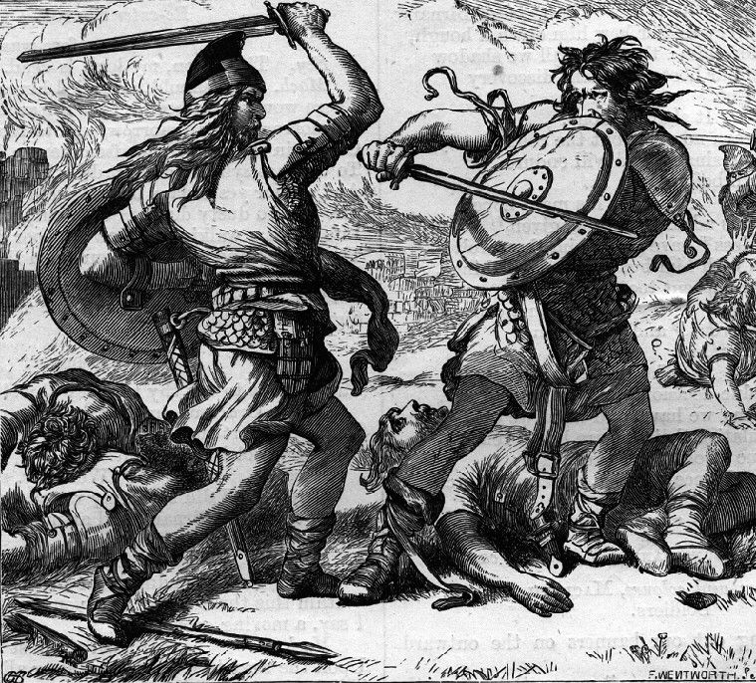
Act One: Justice and retribution
“Till he faces the slave; Which ne’er shook hands, not bade farewell to him”

Slide 4
Act One: Justice and retribution retribution: punishment inflicted on someone as vengeance for a wrong or criminal act.
Macbeth imagines the ‘even-handed justice’ that will see his punishment for Duncan’s murder (1.7)
He also states that the ‘unlineal hand’ will take his throne away (3.1)
In an earlier moment Banquo is shown to be ‘in the hand of God’ (2.3)
Translation: putting himself in God’s hands, with God’s help he’ll fight against treason/treachery

Slide 5
Tyranny
Macbeth’s people live ‘under a hand accused’ – Lennox (3.6)
Shakespeare presents rightful kings, like Malcolm and James I, as characters who can heal the sick just by a touch “Such sanctity hath heaven given his hand” (4.3) THIS CONTRASTS MACBETH’S BLOODY HANDS

Slide 6
Macbeth tries to detach himself from his ‘deeds’
M: The very firstlings of my heart shall be/The firstlings of my hand (4.1)
M: The eye wink at the hand (1.4)
M: what hands are here? Ha! They pluck out mine eyes (2.2)
M: Come, seeling night, scarf up the tender eye of pitiful day; and with they bloody and invisible hand (3.2)

Slide 7
LM: my keen knife see not the wound it makes (1.5)

Slide 8
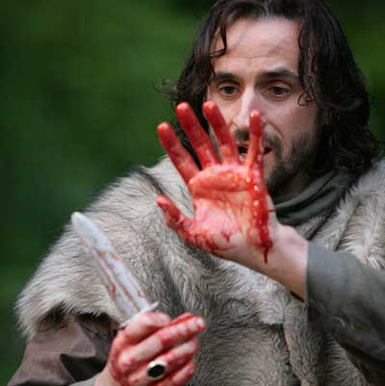
“A little water clears us of this deed” (Lady Macbeth, 2.2)
Macbeth fears his hands will “ne’er be clean”
However, later in the play in Act 5 Lady Macbeth is scrubbing her hands to clear her of the guilt she feels

Slide 9
Lady Macbeth
Dies ‘by self and violent hands’ (5.8)
Her final message to Macbeth: “Give me your hand. What’s / Done cannot be undone” (5.1)
Maintaining the symbolism that hands are a place where evil deeds are done

Slide 10
Witches
“weird sisters hand in hand (1.3) work on the pilot’s thumb…
The apparitions (Act 4) are holding significant items…

