Slide 1
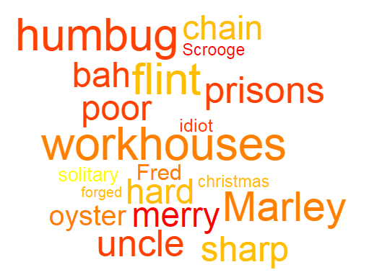
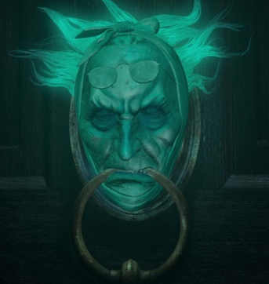
TRANSFORM: the events which unfold in Stave One into a storyboard, containing no fewer than six images and no more than eight. Add a suitable quotation to each of your images.
EXTEND: Compare Dickens’ initial depiction of Scrooge with the depiction at the opening of Stave Five. What differences do you notice? List up to five.
CRITICISE:
“Scrooge is entitled to use his money however he chooses!” Make a list of arguments you could use to counter this viewpoint.
PRIORITISE: Select three key quotations from Stave One. Then, rank them 1 to 3 in order of their importance.

