Slide 1
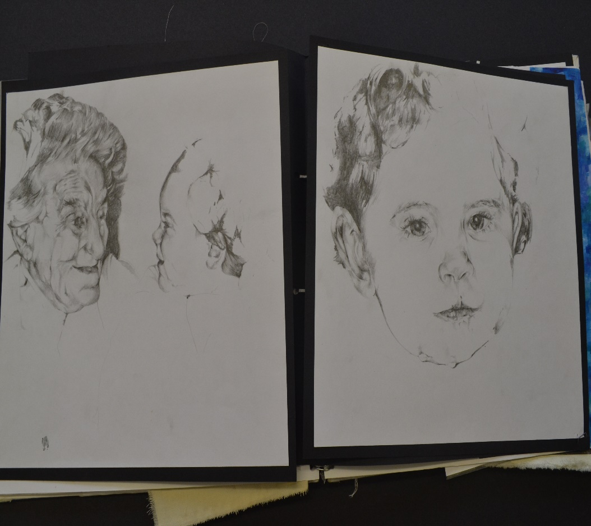
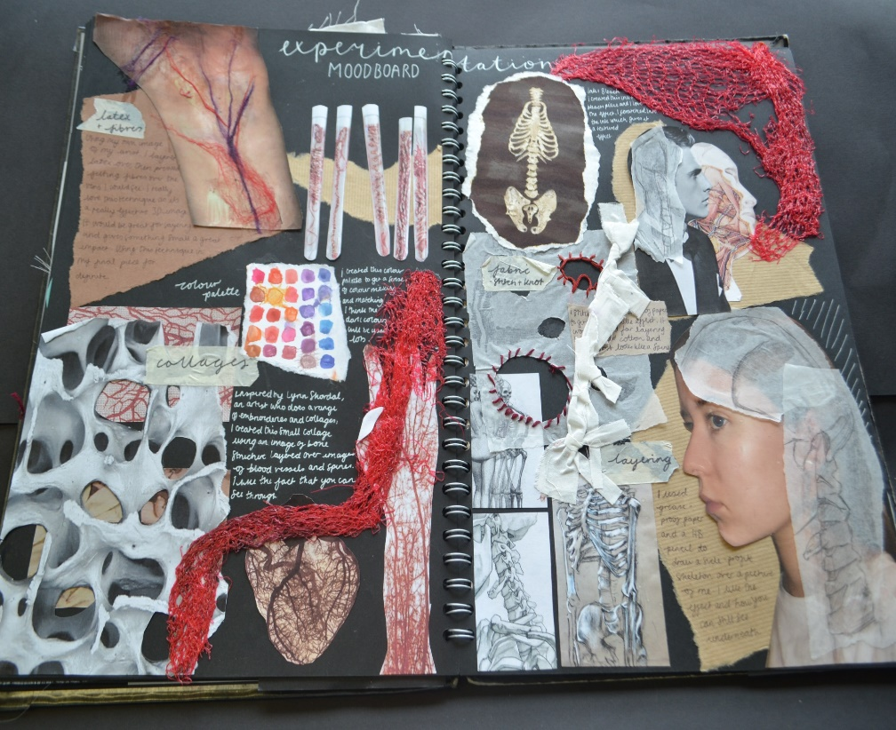
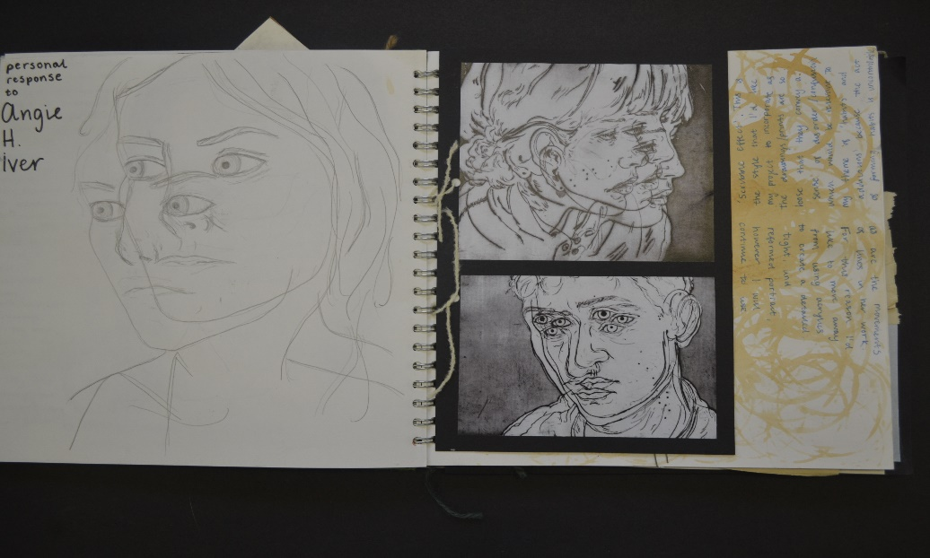
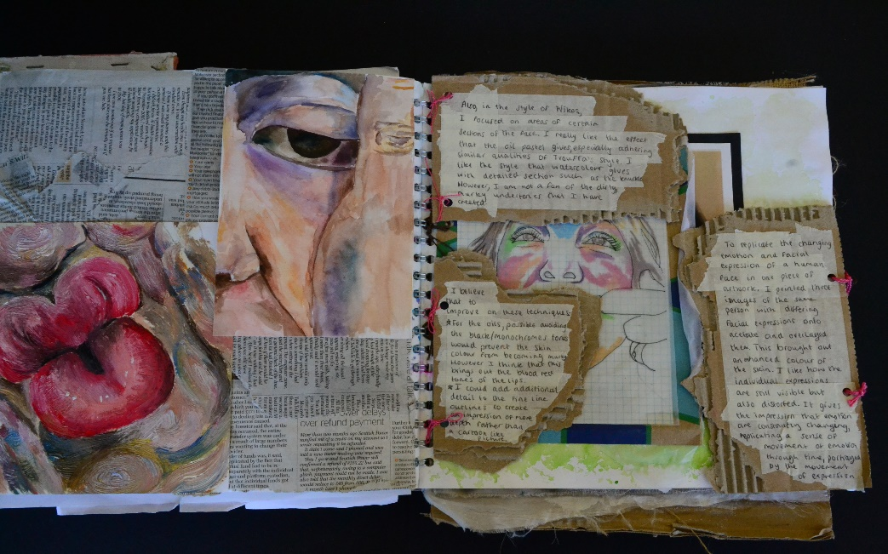
GCSE ART
2 year Course
60% COURSE WORK
40% Exam

Slide 2
G.C.S.E Art
Curriculum Road Map
KS4
Creative apprenticeships
Hand in all your work for marking.
Final exam/ produce a final piece with no interruptions. Your going to love this!
Foundation/diploma Course at college – leading to degree course.
GCSE Examinations
40%
In-class
Coursework 60% and intervention
A-Level Art
Be in charge, you are independent!
Review and refine your final ideas, your nearly there!
Finalize presentation of work.
Which artists have you chosen? who's inspiring you?
You choose the materials and the message you are projecting
COURSEWORK
Build on techniques and processes
Gather primary source share the excitement
Independent project
Proposal/ set the scene
Share ideas, strong research links begin
Year 11
Implement trip information into new projects .
Experience a mock exam.
Trips/visit galleries, view the work others.
Researching
Tutorials/ nurture groups
COURSEWORK
Introducing and action independent ideas
Aims and
objectives
Take your own photos gather primary source.
Reviewing and refining work.
GCSE Art
Managing time/ becoming independent
Year 10
UNDERSTANDING THE ASSESMENT OBJECTIVES
Who inspires us learning how to research and inject ideas,
COURSEWORK
Workshops/ work with other artists learning new techniques and skills.
Introduction to the course. Start new project Natural form.
Experiment with new materials

Slide 3
Take G.C.S.E Art if……
You like being creative
Have an open mind
Like Solving problems
Do you like investigating and experimenting with new techniques and materials?
The word ART umbrellas many different things here are a few:
Painting, Printing, Textiles, sculpture, Drawing, digital art, illustration, Photography.
Art in professions/ Careers can work along side other subjects and is used as a collaborative for example. Stage production, film, fashion, design,

Slide 4
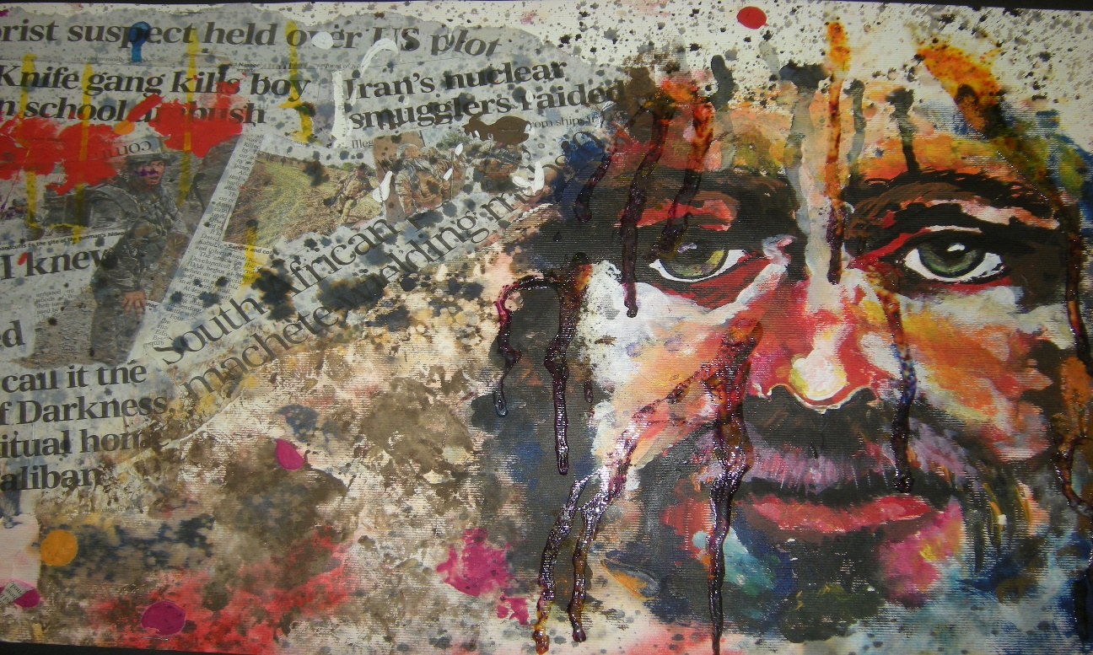
Felting and mixed media.

Slide 5
Topics and themes that we will explore within the course.
Natural form
Portraiture
Identity
Sculpture/ 3D
Independent chosen theme in Year 2.

Slide 6
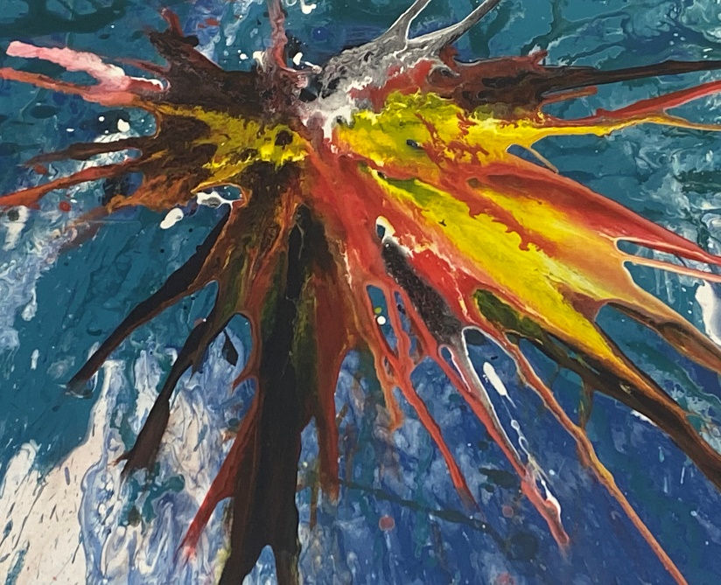
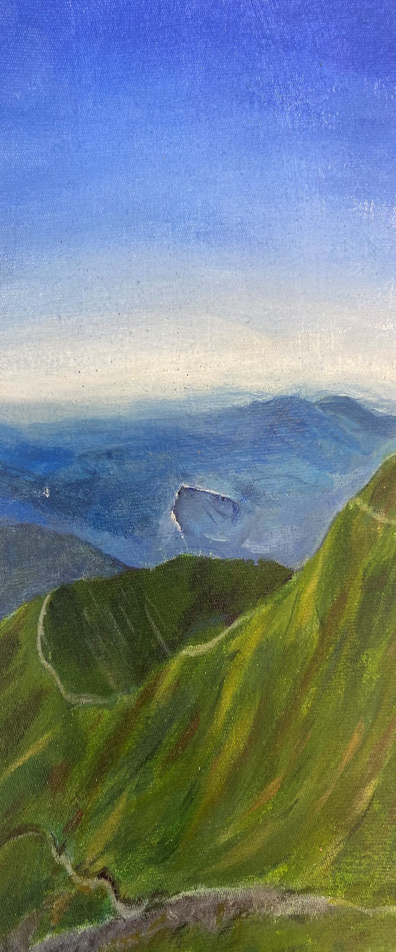
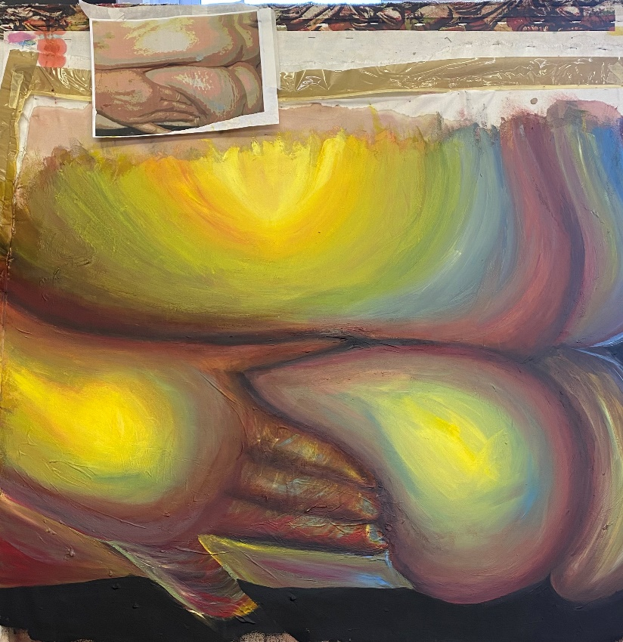

Slide 7
creative careers
https://www.youtube.com/watch?v=ArnhItrVuFM

