Slide 1
English Language Paper Two – 80 marks; 1hr 45 mins
READ SOURCE A FIRST – spend at least 5 minutes reading and underlining key information
Q1 4 marks 5 mins
Choose four true statements
Read the statements carefully (sometimes they try to trick you)
Q2 8 marks 8 mins Summary of both texts
Read each text again
Two things from each is enough (4 short paragraphs in total)
Statement about Source A → Quote → This suggests…
Statement about Source B → Quote → This suggests…
Repeat
NOW READ SOURCE B – spend at least 5 minutes reading and underlining key information
Q3 12 marks 12 mins Language
Stick to the lines they give you
Two or three short paragraphs is enough
Pick out feature and quote (The writer uses the simile “like a balloon”…) → analyse effects → repeat
Key language features to remember:
Noun | Names a thing
Adjective | Describes a noun
Verb | Action (doing word)
Adverb | Words that tell you how an action is performed (-ly words)
Simile | Like or as something
Metaphor | Is something else
Personification | Making non-human thing seem human
Zoomorphic language | Person/thing described as an animal

Slide 2
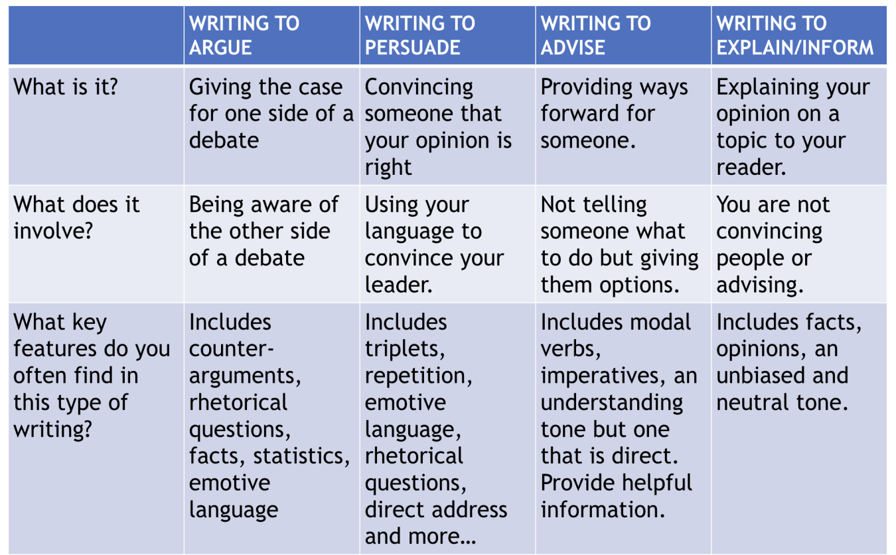
Q4 16 marks 20 mins Comparing viewpoints and methods
Compare the writers’ attitudes/viewpoints on the subject and the methods (language and/or structure) they use to get these viewpoints across.
Focus on how the writers think/feel about the subject they are writing about.
Four paragraphs (two about each source – ABAB)
Use SEIZED SEIZE to structure your answer.
Statement (about an attitude in Source A)
Evidence (quote from Source A)
Inference (This suggests…)
Zoom in (on language)
Effect (of this language on the reader)
Discourse marker (Similarly/in contrast)
Statement (about an attitude in Source B)
Evidence (quote from Source B)
Inference (This suggests…)
Zoom in (on language)
Effect (of this language on the reader)
Q5 40 marks (24+16) 45 mins Non-fiction writing
Plan for at least 5 mins (you should know exactly what each paragraph will be)
Leave at least 5 mins for proof reading at the end
Styles of writing (you could be asked to do any of these)
Repeat

Slide 3
Types of text
Text type | Features you must include
Newspaper Article | Headline, kicker (strapline), clear sequence of paragraphs. Formal tone
Magazine Article | Headline, kicker (strapline), subheadings. Less formal/more chatty tone.
Letter | Clearly addressing reader (Dear Sir/Madam), sign-off (Yours Sincerely/Faithfully), date
Speech | Clearly addressing an audience (greeting and sign-off), discourse markers (firstly, finally)
Leaflet | Clear heading, subheadings and subsections, fact/info boxes. Appropriate tone for subject (serious or informal)

