Slide 1
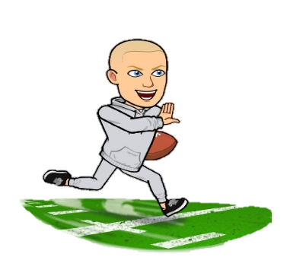
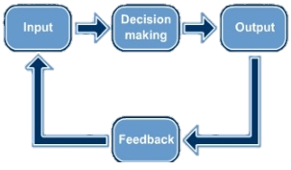
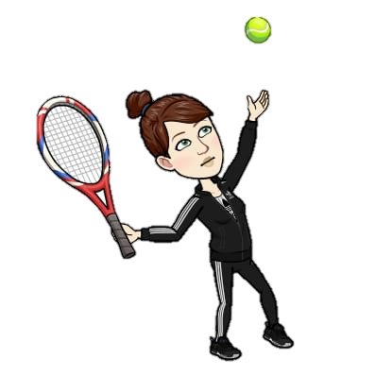
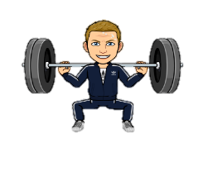
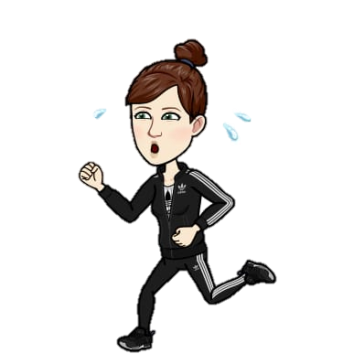
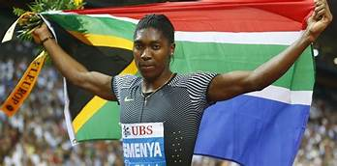
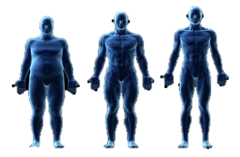
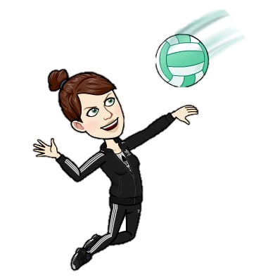
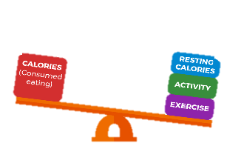
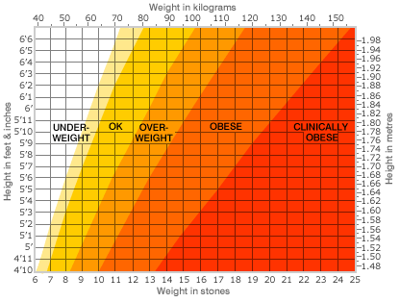
GCSE PE
Learning Journey at William Howard School
(Year 10)
Explain the importance of motivation in sport & justify the positive and negative impact of each type of motivation on performance
Explain the traits of each personality type and how they are suited to particular sports.
Apply Aggression to sporting examples & explain why it may be needed in sport.
4.8
Motivation
4.7
Personality
Types
4.6
Aggression
Describe and explain how athletes may use Stress management techniques to manage arousal.
Define Motivation & explain the 2 types of motivation:
Intrinsic
Extrinsic
Define and Explain the 2 Types of Personality
Define Aggression & describe the 2 Types of Aggression:
Direct Aggression
Indirect Aggression
Begin to link skills within sport to appropriate levels of Arousal.
Explore & Apply the technique of SMART:
Specific
Measurable
Accepted
Realistic
Time-bound
Define and describe areas
of feedback after the completion of a skill:
Intrinsic Feedback
Kinaesthetic Feedback
Extrinsic Feedback
Justify the relevance of using each type
of guidance with different performers
Define Arousal & illustrate the graph which represents “Inverted-U” theory.
Identify and Describe the 4 steps in the Information Processing model
4.4
Guidance
&
Feedback
4.5
Arousal
Describe and explain the 2 Types of Goals:
Performance goals
Outcome Goals
4.3
Information Processing
4.2
Goals
and
Targets
Explain how the speed of the process changes with experience in sport
Explore 4 types of Guidance & explain the positives and negatives of each
Investigate the 6 Types of Feedback. Giving advantages & disadvantages for all.
Revision for End of Chapter Test
Explain the strategies to combat hooliganism and poor behaviour by spectators:
Early Kick-offs
All Seater Stadiums
Fan Segregation
Alcohol Restrictions
Improved Security
Explain and justify why the World Anti-Doping Agency (WADA) & UK Anti-Doping (UKAD) implements rules regarding PEDs
Develop the ability to classify sporting skills in to specific continuums.
Identification of the 4 Classifications of Skill continuums.
Define the term Hooliganism
Define the
term Home Field Advantage
Chapter 4
Sports
Psychology
5.5
Spectator
Behaviour
Evaluate the benefits & disadvantages of taking PEDS & reasons why some performers take them.
Define and Describe the terms Skill & Ability
Investigate reasons for Hooliganism and the impact on the reputation of sport.
Evaluate the positive & negative influences of spectators being at sporting events
Identify the 7 forms
of Performance
Enhancing Drugs (PEDS):
Stimulants
Narcotic Analgesics
Anabolic Steroids
Peptide Hormones
Diuretics
Blood Doping
Beta Blockers
Identify and Explain the 4 ways in which the media implements mass communication e.g. Broadcasting, Internet & social media, Print and Outdoor media.
Explain the impact of sponsorship and media for:
Performer
Official
Sport
Spectators
Company
Identification of the
main forms of Technology
used in sport e.g. Hawkeye, Performance analysis aids & TMO
Defines the terms Sponsor & Sponsorship
5.4
Ethical
Conduct by
Performers
Define and describe the key terms:
Etiquette
Sportsmanship
Gamesmanship
Contract to complete
Define the terms Commercialisation and Media
5.3
Impact of Technology
in Sport
5.2
Commercialism
In
Sport
Explore the 3 areas of Sponsorship & how it can benefit sports teams and individuals
Explore how other forms of technology are used or being introduced in to sports
Discuss the impact of Technology for the 5 main platforms e.g. performer, official etc
Explain how Disability might impact
participation in sport and how sport is adapted to suit all needs
Explain how Family, Friends & Peers can influence how and why we take part in sport
Identify how Gender can impact participation & factors which might impact individuals
Revision for End of Chapter Test
Explain the consequences of Dehydration on the body & its impact on performance
Define the terms:
Hydration
Dehydration
Rehydration
Chapter 5
Socio-Cultural Influences
Investigate ways to link Age to participation in sport and how factors might affect this.
Identification of the
5 different factors which can impact participation in sport
6.6
Maintaining Water
Balance
Explain the role each nutrient has in the body and how it can be important to athletes.
Explore how ethnicity (incl race, religion and culture) might affect participation in sport.
Explain how water is lost from the body during exercise and the reasons why.
Identify Body Classifications
Ectomorph
Mesomorph
Endomorph
Define Energy Balance: investigate the correlation between calories taken in and calories burned in exercise on body weight.
Explain the term Nutrition and how this relates to a balanced diet.
6.3
Somatotypes
6.4
Energy Use
6.5
A Balanced
Diet
Identify food sources which contains certain nutrients and how this forms a balanced diet.
Identification of the term Ill Health & how it impacts overall Health and Well-Being
Explain how certain body types are suited to certain sports and/or positions
Define the term Calorie and how it is obtained from food.
Explore the factors affecting calorie intake e.g. Age, Height, gender.
Explain the characteristics of a balanced diet
Identify the macronutrients contained in food (e.g. Fats, carbohydrates,
& proteins)
Identify how obesity affects some Components of Fitness & performance in sport
Define the term Obesity & explore the use of Body Mass Index to calculate it.
YEAR
Introduction to Qualitative and Quantitative data & how it is used in questionnaires or by interviewing people.
Investigate the term Social Health and how it allows us to build relationships with others
Gain an understanding of the term Physical Health and how to maintain it
Introduction to AQA GCSE PE and Assessment
10
6.1
Consequences of a Sedentary Lifestyle
6.1
Physical, emotional and social well-being
Chapter 6
Health, Fitness & Well-being
Identify the 7 Consequences of not taking part in regular physical activity e.g. poor sleep patterns & poor self-esteem
Define the term Fitness and how it relates to maintaining overall health
Explore Mental Health including how to define & maintain it and how to manage stress.
RESPECT|RESILIENCE | RESPONSIBILITY Be The Best You Can Be

Slide 2
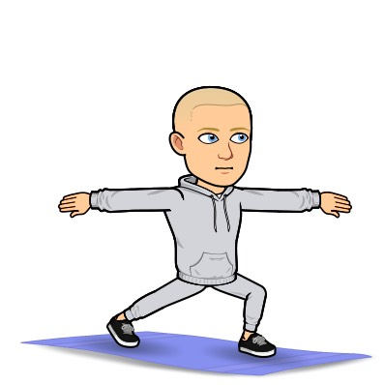
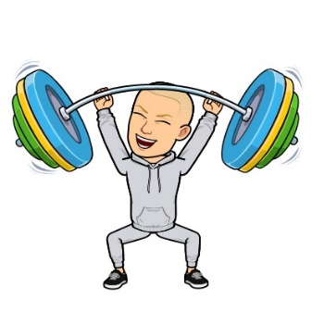
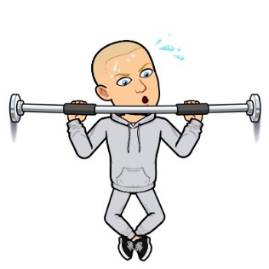
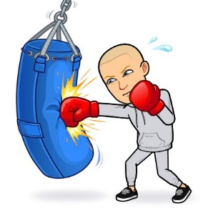
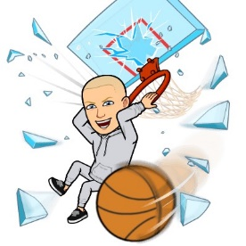
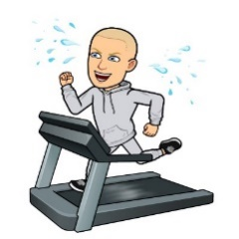
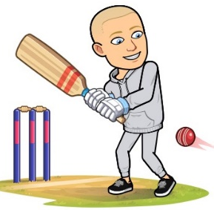
GCSE PE
Learning Journey at William Howard School
(Year 11)
Revision for paper 1 and 2
Be able to explain the term plane and axes.
Using your knowledge of joints identify and explain the basic movements that can occur at joints.
Understand and explore the term mechanical advantage and apply this to sporting activities.
3.3
Planes and axes
3.2
Basic movements
Third class lever – Fulcrum, effort, load.
Explore the different planes of movement and axes of rotation in the body. Using this knowledge apply to sporting activities.
Apply your knowledge of basic movements to real life sporting activates.
second class lever – Fulcrum, load, effort.
Identify and explain the immediate effects of exercise e.g. Increased breathing rate.
Using your knowledge of the cardiorespiratory system identify and explain long term effects of exercise e.g. Muscular hypertrophy.
Revision for End of Chapter Test
Understand how movement occurs in the body. Levers turn about an axis.
First class lever – Load, fulcrum, Effort
Explore the process of recovery:
Cool down
Diet
Ice baths
1.5
The effects of exercise
Chapter 3
Movement analysis
Identify and explain the short term affects of exercise e.g. You may become fatigued during exercise.
Understand the key terms fulcrum, load and effort.
Explore what lactic acid does during exercise and the term EPOC.
Be able to define the terms:
Stoke Volume
Cardiac output
Heart rate
Identify and explain the 5 different ling volumes.
Tidal volume
ERV
IRV
Residual Volume
Vital capacity
Gain an understanding of the process of gaseous exchange and be able to define the term diffusion pathway.
Using your knowledge of blood vessels explain the structural differences between each vessel and their role in the body.
Explore the structure of the heart e.g. Right ventricle.
Gain an understanding of the respiratory system. What is its primary role? What is it comprised of? E.g. Trachea
Define the terms aerobic and anaerobic exercise.
1.4
Aerobic and anaerobic exercise
Be able to describe the process of redistribution of blood.
Be able to identify the 3 different blood vessels e.g. Arteries.
Define the term cardiovascular system.
Explore the mechanics of breathing e.g. How does the diaphragm move. Apply to sporting examples.
Explore the cardio-respiratory system.
Identify the main bones in the body e.g. Scapula and humerus.
I identify and explain the four types of bones along with articulating bones.
Be able to distinguish between a ball and socket joint and a hinge joint.
Be able to identify some of the muscles found in major joints of the body: Shoulder, elbow, knee, hip, knee and ankle.
1.3
The cardio-respiratory system
Revision for End of Chapter Test
Chapter 1
Applied anatomy and physiology
1.2
The structure and function of the muscular system
Gain an understanding of the synovial joint and how each aspect of the joint helps provide movement.
Explore the types of movement that can occur at each joint. Apply these joint movements to sporting activities.
Gain an understanding of muscles, tendons and ligaments. Be able to identify some of the main muscles in the body e.g. Biceps and triceps.
Explore the ways in which a muscle can contract (isotonic and isometric) and apply to sporting activities.
Explain the various steps athletes can take to ensure a proper cool down/recovery are achieved.
Define the terms agonist and agonistic pairs and apply to sporting activities.
Gain an understanding of why a performer may take specific steps to warm up and cool down.
Gain an understanding of why a professional sporting season is split into sections e.g. pre-season.
Apply your knowledge of training methods to your coursework – Which method is best to improve your fitness weakness.
Identify the component of fitness that is training when carrying out each training type.
3.9
Warm up and cool down
3.8
Training seasons
3.7
Preventing injury
Identify and explain the 4 different stages of a warm up.
Acquire he knowledge to Identify and explain each training season in a professional sporting calendar.
Identify and explain the 8 steps performers can take to prevent injury e.g. Keep hydrated
Investigate the advantages and disadvantages of each training method.
Identify and explain the 8 different training methods e.g. continuous training – steady state training, 80% of MHR for at least 20 mins
Identify and understand the difference between quantitative and qualitative data. How can this be applied to testing?
Explore each fitness test and understand how each test is carried out.
Apply your knowledge of fitness testing to your coursework. Which is the most appropriate test for your fitness weakness.
Understand and explain and the terms SPORT and FITT e.g. – F – Frequency – How often an athlete may train.
3.6
Types of training
Explore aerobic training zones - 60-80% of MHR
3.4
Principles of training
3.5
Training thresholds
Understand the rational behind why athletes subject themselves to fitness test.
Be able to identify all 11 fitness tests e.g. The Illinois agility test.
Identify which component of fitness is the focus in each test e.g. The ruler drop test – Reaction time.
Identify the principles of training – FIIT SPORT
Design your own training session applying the principles of fitness.
Gain an understanding of why athletes use training zones.
Explore anerobic training zones – 80 – 90% MHR.
3.3
Fitness
testing
Explore why different performers may need different COF to perform in their different sports.
Be able to identify all 10 components of fitness e.g. Agility or reaction time.
Reminder of AQA GCSE Assessment in year 11
Be able to define and understanding of the term health.
3.1
Health and Fitness
Apply your knowledge of components of fitness to your coursework/chosen sport.
Physical Training
3.2
Components of fitness
Chapter 3
Define components of fitness e.g. Flexibility – The range of movement at a joint.
Explore the term fitness and understand what it means to be physically ‘fit’
YEAR
11
RESPECT|RESILIENCE | RESPONSIBILITY Be The Best You Can Be

Slide 3
