Slide 1
How to stay healthy and support your wellbeing
How do you motivate yourself to revise?
How do you get a balance?
How can you reduce your stress and support your wellbeing?

Slide 2
Invest in Yourself 7 steps to a Healthy Mind
SLEEP TIME
FOCUS TIME
PHYSICAL TIME
DOWN TIME
TIME TO CONNECT
TIME IN
PLAY TIME

Slide 3
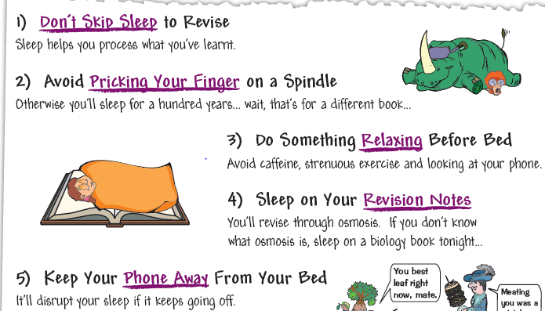
Invest in Yourself 7 steps to a Healthy Mind
FACT – you need between 8½ and 9½ hours sleep per night
That is the correct amount of time in order for your brain to grow, for your memory to consolidate the days learning and for the brain to rest and remain fit.
The correct amount of rest allows your brain to deal with stresses, concentrate, remember things, solve problems, handle emotions and think effectively.
SLEEP TIME

Slide 4
Invest in Yourself 7 steps to a Healthy Mind
Moving your body grows the brain.
When we exercise we strengthen neural pathways in our brain – this helps us remember more.
Physical movement makes us feel better and improves our mood and keeps our mind healthy.
PHYSICAL TIME

Slide 5
Invest in Yourself 7 steps to a Healthy Mind
Invest in yourself – take time to focus on your feelings, thoughts and senses.
Practice short mindfulness exercises such as breathing. This helps you to focus for short amounts of time. You can build this up over time.
These exercises support the growth of the brain and mental well-being. There is a science behind this that says mindfulness practice increases health and improves energy levels
https://www.youtube.com/watch?v=SEfs5TJZ6Nk

Slide 6
Invest in Yourself 7 steps to a Healthy Mind
Concentrate fully on one thing at a time. Avoid texting, social media, conversations etc. when revising – this is viewed as multi-tasking and means the brain isn’t giving its full attention to what you want.
Concentrating on one thing activates specific circuits in the brain and these strengthen during the process.
Strengthening these circuits make long-term structural changes to the brain function- which is the basis for learning and remembering.

Slide 7
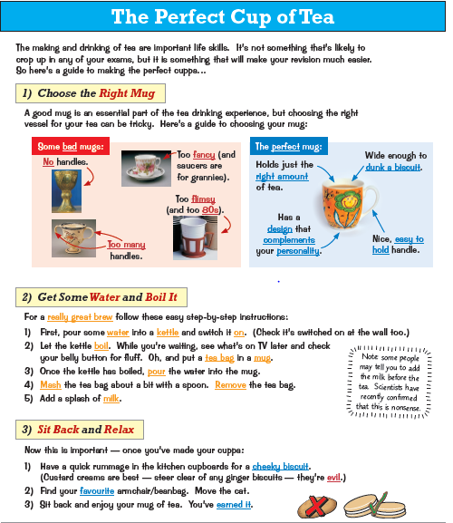
Invest in Yourself 7 steps to a Healthy Mind
Time to unwind and let your brain have a rest.
This is important time for the brain to ‘sort itself out’ – recharge its batteries.
This chill out time means no plans or arrangements and let your imagination go wherever it wants.
Don’t feel guilty.

Slide 8
Invest in Yourself 7 steps to a Healthy Mind
Laughing is essential– when we have fun the brain grows.
Let your brain be active in a different way
Be creative, try something new – time to think about something completely different.

Slide 9
Invest in Yourself 7 steps to a Healthy Mind
TIME TO CONNECT
Connecting with others (face-to-face) makes our lives healthy, meaningful and happy.
Supportive relationships make us healthier and happier – reminds us we are not alone.
Spend time outside in the fresh air – reconnect with nature and the environment.

Slide 10
Set yourself three revision rules which you stick to:
For example:
Phone switched off
Brain break every 20 minutes for 5 minutes
Drink and eat healthily

Slide 11
Final things to think about before the exam
Make sure you have pens, ruler and pencils in a clear wallet or pencil case.
Check if you need any extra equipment like a calculator, protractor or coloured pencils.
Pack your bag the night before so you are not in a rush in the morning.
Leave time for breakfast before setting off for school.
Check you know where you are sitting the exam.

Slide 12
Good luck and remember:
“Some people dream of success while others wake up and work hard at it.”

