Slide 1
Freud, psychoanalytic and macbeth

Slide 3
Literary Criticism…
… Something you already do
It’s judging and commenting on the qualities and character of literary works.
Different ways/viewpoints that you can use when approaching pieces of literature.
Feminist, Marxist, postcolonial and psychoanalytic are some of the main psychoanalytical are some of the main ones

Slide 4
Definitions
Rational: having or exercising reason, sound judgment, or good sense: being in or characterized by full possession of one's reason; sane.
Irrational: without the faculty of reason; deprived of reason; without or deprived of normal mental clarity or sound judgment.

Slide 5
Why?

Slide 6
Psychoanalysis – A definition
A system of psychological theory and therapy which aims to treat mental disorders by investigating the interaction of conscious and unconscious elements in the mind and bringing repressed fears and conflicts into the conscious mind by techniques such as dream interpretation and free association.

Slide 7
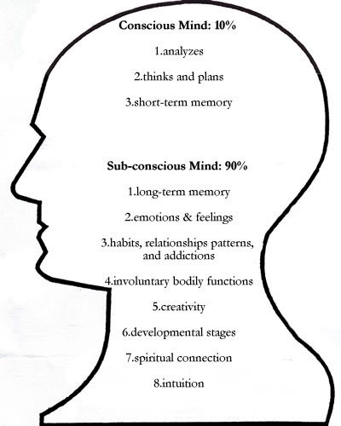
Freud (1915) described conscious mind, which consists of all the mental processes of which we are aware, and this is seen as the tip of the iceberg. For example, you may be feeling thirsty at this moment and decide to get a drink.
According to Freud, the unconscious mind is the primary source of human behaviour. Like an iceberg, the most important part of the mind is the part you cannot see.

Slide 8
Psychoanalytic Criticism
Psychoanalytic criticism is form of literary criticism which uses some of the techniques of psychoanalysis in the interpretation of literature to fully understand the motives, thoughts and actions of characters.

Slide 9
Please Note
You are not diagnosing characters with mental disorders. You are not a doctor and the characters are not your patients.

Slide 10
Sigmund Freud and Psychoanalysis
Founding father of psychoanalysis, a method for treating mental illness and also a theory which explains human behaviour.
Emphasized the importance of the unconscious mind and how the unconscious mind governs behaviour,
The goal of psychoanalysis is to make the unconscious conscious.
Developed a more structural model of the mind comprising the entities id, ego and superego.

Slide 11
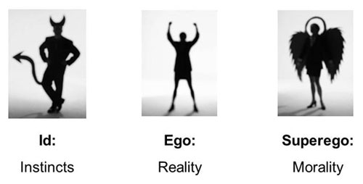
The Id, Ego and Superego

Slide 12
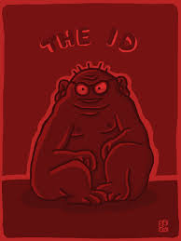
The Id
The id contains all of our most basic animal and primitive impulses that demand satisfaction. It’s that little devil that sits on your shoulder, whispering temptations and spurring you on.

Slide 13
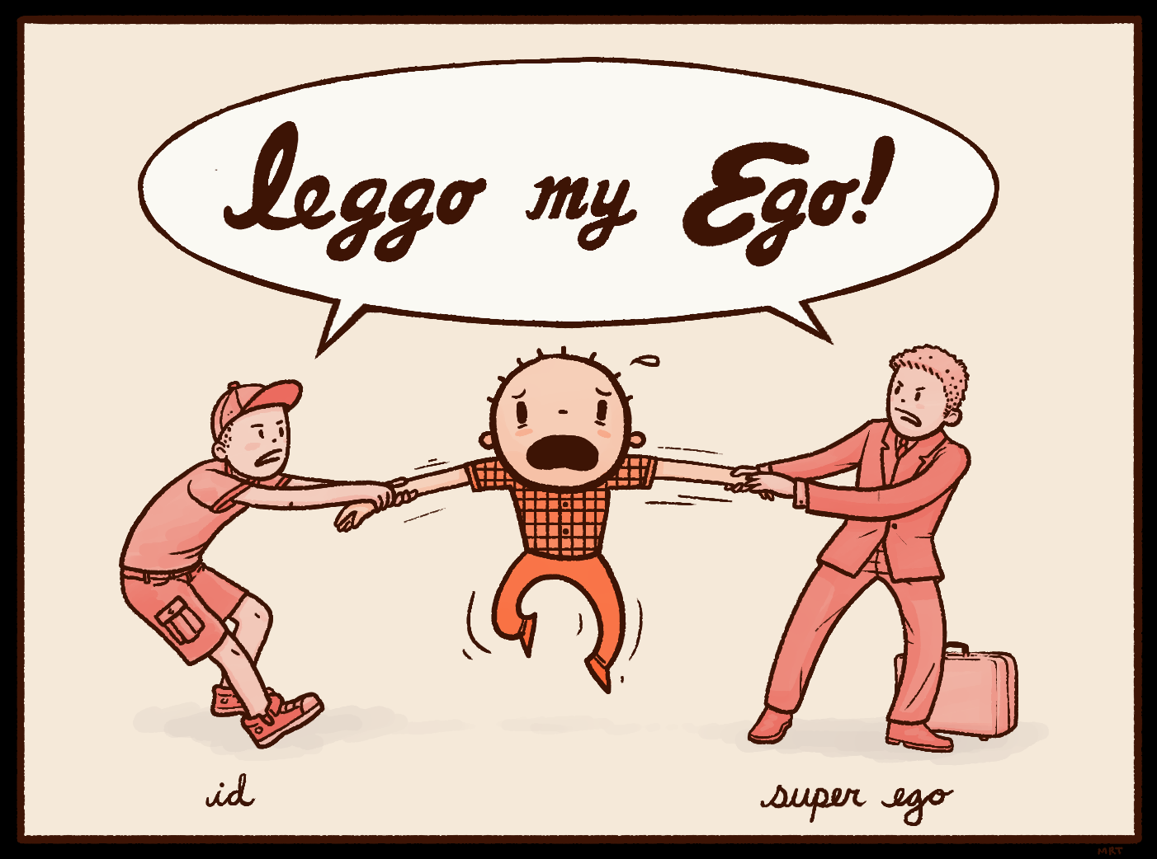
The Ego
The ego’s main function is to mediate between the id’s demands and the external world around us — reality in other words.
Even though the ego finds itself in conflict with the id, satisfaction is not abandoned.
So the ego negotiates with the id in order to get it what it wants without costing it too much in the long run.

Slide 14
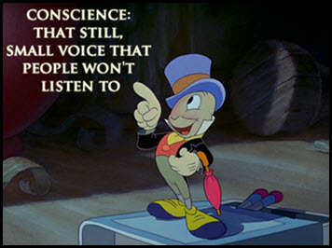
The Super Ego
Superego is another name for your conscience. It expects your ego to be strong and effective in its struggles against the I’d force.
But does everyone have a conscience?

Slide 15
Applying Psychoanalysis to Macbeth
The id - willing to kill this beloved leader to gain ultimate power.
The ego - His Ego tells him that he shouldn't kill Duncan because he's a guest in his home and that's inconsiderate
The superego - His Super-Ego tells him that it's morally wrong to kill another person.

Slide 16
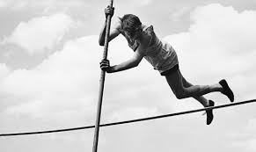
The overpowering Id
‘Vaulting ambition which o'erleaps itself and falls on the other side’

Slide 17
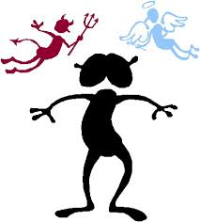
The ‘realistic’ Ego
‘First, as I am his kinsman and his subject,
Strong both against the deed; then, as his host,
Who should against his murderer shut the door,
Not bear the knife myself.’

Slide 18
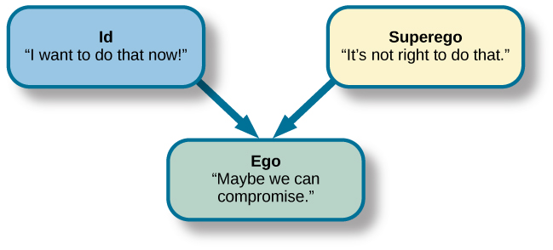
Macbeth does have a conscience, for a bit anyway
‘We will proceed no further in this business’

Slide 19
The superego/Conscience
Until the end of the play, we would certainly argue that neither Macbeth or Lady Macbeth had a conscience and allowed the desires (their id) to possess them in order to fulfil the witches’ prophecy, as Lady Macbeth closes ‘up the passage to remorse’ and Macbeth actually committed the fateful ‘deed’ and then went on to have his best friend and foil Banquo murdered.

Slide 20
The Subconscious Mind takes control
In Act 5, Scene 1 we see the full extent of the subconscious mind taking control. As when lady Macbeth is sleepwalking, whilst trying to rub her hands, clean (‘out damned spot, out I say’) helping to prove Freud’s theory that the unconscious mind is the primary source of human behaviour., and like an iceberg, the most important part of the mind is the part you cannot see. The part that conceals or true thoughts, emotions and motives.

Slide 21
WRITING CRITICALLY
Simple Macbeth is presented as a “tyrant” later in the play.
Clear Macbeth’s character develops throughout the play, becoming a “tyrant” when once he was “noble” and “worthy” of his good reputation.
Critical Shakespeare’s presentation of Macbeth allows the audience to witness the downfall of a once “noble” man, introduced to them in the earlier scenes as “brave” and “worthy”, who is then driven by both greed and ambition to become a murderous, treacherous “tyrant”.

Slide 23
Critical Verbs
The writer… The use of (technique) (critical verb)… By (critical verb+ing) this the writer/he/she…
In order to (critical verb) character/issue/viewpoint the writer uses…
Throughout the extract/text the writer (critical verb)…
*builds *develops *illustrates *implies *indicates *evokes *parallels *connotes *contrasts *juxtaposes *denotes *amplifies *emphasises *reflects *mirrors *intensifies *reinforces * adumbrates *proposes * evidences *reiterates *portrays *reminds *presents *represents *demonstrates *foreshadows *conveys *symbolises *isolates *highlights *insinuates *hints *exhibits *projects *define *invokes *constructs *advocates *criticises *signifies *asserts *layers *begins *introduces*maintains *compliments *contradicts *balances *delays *generates *instigates

