Slide 1
Year 10 Information Evening Welcome

Slide 2
1
2
3
4
5
6
7
8
9

Slide 3
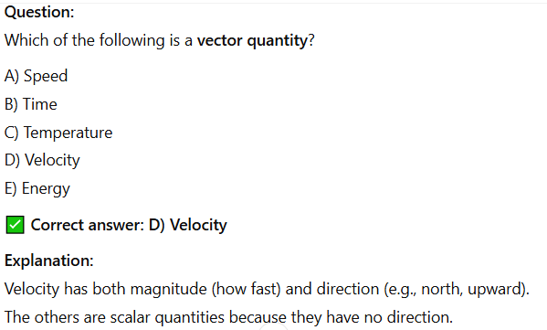
Physics
1)
ANSWER
Velocity

Slide 4
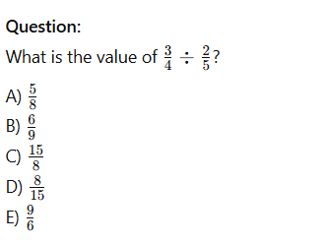
Maths
2)
ANSWER

Slide 5
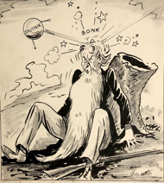
History
3)
Source A is critical of the USA. How do you know?
a) The source criticises America as they have been unable to shoot down Sputnik.
b) The cartoon symbolises how Sputnik was able to attack the USA.
c)The man representing America is shown sleeping while Sputnik hits him, suggesting the USA had been complacent.
d) The source criticises American cooperation with the Soviet Union in helping to define Sputnik.
.
Source A: British cartoon from 1957 after the launch of Sputnik I. The man represents America.
ANSWER
c)The man representing America is shown sleeping while Sputnik hits him, suggesting the USA had been complacent.

Slide 6
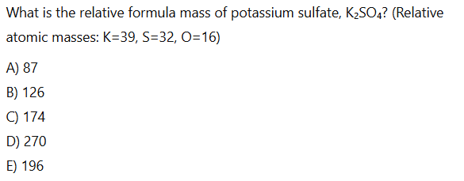
Chemistry
4)
ANSWER

Slide 7
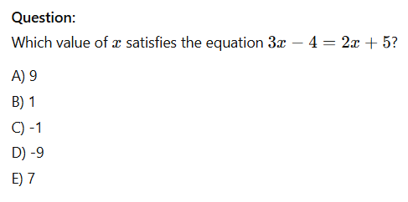
Maths
5)
ANSWER
9

Slide 8
Biology
6)
Which statement correctly compares prokaryotic and eukaryotic cells?
A) Prokaryotic cells have mitochondria, but eukaryotic cells do not. B) Eukaryotic cells lack genetic material. C) Prokaryotic cells store DNA in a nucleus. D) Eukaryotic cells have membrane-bound organelles; prokaryotic cells do not. E) Both types of cells are the same size and structure.
ANSWER

Slide 9
Physics
Question: A kettle transfers 120,000 J of energy in 80 seconds. What is the power output?
A) 960 W B) 1500 W C) 800 W D) 1000 W E) 120 W
7)
ANSWER

Slide 10
Chemistry
Why do ionic compounds have high melting points?
A) They contain small, non-reactive atoms. B) They have weak intermolecular forces. C) The oppositely charged ions are held together by strong electrostatic forces. D) They have large covalent molecules. E) The ions are free to move in solid form.
8)
ANSWER

Slide 11
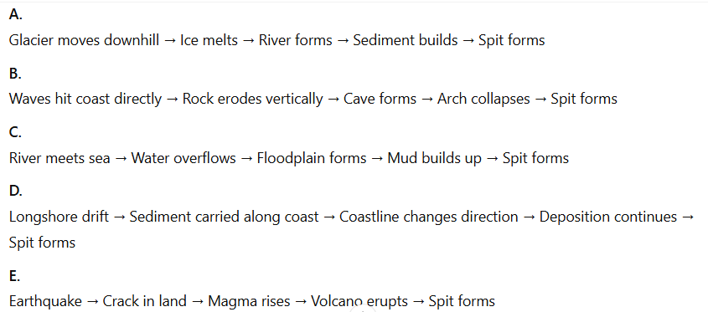
Geography
9)
Explain how a coastal spit is formed
ANSWER

Slide 12
SZL WELLBEING AND SUPPORT

Slide 13
Well-Being
In school
At home
Clear information about focus
An exam timetable
Shared procedures
Open door in the YGT
Liaison with Learning Support
Contact with home
Support with revision
A space to work
Boundaries
Rest breaks
Management of phone use
Balanced meals
Time outdoors/exercise

Slide 14
Create a place to work
A desk
A chair
Books
Pens
Highlighters
Post it

Slide 15
TPR THE IMPACT OF COVID

Slide 16
R
1
2
3
4
5
6
6
7
8
9
10
The last two years of KS2 are a time when children:
develop abstract and logical reasoning, as well as critical thinking.
often move from “learning to read” to “reading to learn.”
develop independence, resilience, and self-regulation.
The interruption to Year 5 and 6 has created students more likely to:
have lower confidence in learning and lower motivation.
find it challenging to adapt to the pace of secondary education.

Slide 17
SZL IQS AND INTERVENTIONS AND ATTAINMENT GRADES

Slide 18
Academic Review
Aspiration
Ambition
Acceleration
Action

Slide 19
Target Grade
A grade to aim for
Based on previous attainment
CAT scores
This Year 10 have no SATS

Slide 20
Don’t put the lid on the jar …
There’s an old story about a boy who catches a live grasshopper and places it in a glass jar and then screws the lid on tightly. The boy watches the grasshopper with great interest. At first, the grasshopper leaps up trying to escape, each time hitting his head against the lid. This goes on for a while until eventually the grasshopper stops jumping and sits at the bottom of the jar.
After a while, the boy removes the lid, providing a clear path to freedom. But now the grasshopper is conditioned to believe that it can’t escape, so it doesn’t jump at all. And so, it stops trying. It is now trapped by a barrier that no longer exists.

Slide 21
Your target is not the limit …
… it's an estimate based on previous attainment …
… it does not define the student !

Slide 22
Current Attainment
This where the teacher thinks the student is now

Slide 23
IQ Groups
Aspiration
High effort and high progress
Ambition
Low effort and high progress
Action
Low effort and low progress
Acceleration
High effort and low progress

Slide 24
IQ Groups

Slide 25
Expected Grade
This is the grade the classroom teacher estimates will be achieved at the end of Year 11 if you continue working as you are

Slide 26
Expected Grade
If the expected grade is below the target – there will be work to do to meet the target by the end of Year 11
The student will be in the Accelaration group or the Action group

Slide 27
Expected Grade
If the expected grade is the same or above the target – the student needs to keep working as they are
They will be in the Aspiration group or the Ambition group

Slide 28
Knowledge and Skills
The assessment
What do you need to revise?
Choose a subject to revise
English Literature
Select a topic you will be examined on
Macbeth
Remind yourself of how you will be assessed
An analysis of an extract based on a theme and/or character
A further analysis of the rest of the play
Content
Plot
Character Retrieval
Themes
Language features
Blank verse
Imagery Retrieval
How to analyse
Planning
Using quotations Practise
Discussing effects

Slide 29
Revision Tasks
Retrieval Tasks
Practise Tasks
Write/cover/check
Lists
Quizzes
Storyboards and diagrams
Planning with mind maps
Redrafting marked work
Writing sample paragraphs
Completing a task independently
Self assessing work using success criteria
Rewriting and improving self assessed writing

Slide 32
TPR REVISION

Slide 33
What should revision actually look like?

Slide 34
Whiteboards Ready!
1
2
3
4
5

Slide 35
According to a 2023 survey of 33,435 students across English schools:
1.What was the most common revision method identified by the survey?
2. What percentage of students only used this method to revise?
3. According to the survey, flashcards were the second most common revision method. However, what did almost half of all students not do with their flashcards?
4. What do you think the third most common method was?
5. According to a survey from 2019, which of the following statements is correct.
Most students focus their revision on strengths and on topics they don't like
Most students focus their revision on weaknesses and on topics they don't like
Most students focus their revision on weaknesses and on topics they do like
Most students focus their revision on strengths and on topics they do like
1) Reading over notes

Slide 36
According to a 2023 survey of 33,435 students across English schools:
1.What was the most common revision method identified?
2. What percentage of students onlyused this method to revise?
3. According to the survey, flashcards were the second most common revision method. However, what did almost half of all students not do with their flashcards
4. What do you think the third most common method was?
5. According to a survey from 2019, which of the following statements is correct.
Most students focus their revision on strengths and on topics they don't like
Most students focus their revision on weaknesses and on topics they don't like
Most students focus their revision on weaknesses and on topics they do like
Most students focus their revision on strengths and on topics they do like
1) Reading over notes
2) 37%
3) Use them
4) Copying out
5) D

Slide 39
Memory
Minority - Active revision e.g. requires significant brain activity, testing and reflection
LONG TERM MEMORY
ADDED VALUE
DO YOU WANT YOUR TIME TO COUNT?
Majority - Passive revision e.g. reading over notes, copying out etc. or revision with distractions
1 hour
24 hours
1 week
Time

Slide 40
Strategic thinking – what is ‘in the bag’
Method: teacher feedback, tests and reflections
THE BAG
Method:
Learn
Test
Check
Repeat
Effective revision that ‘goes somewhere’ to produce a sense of progress
PROGRESS

Slide 41
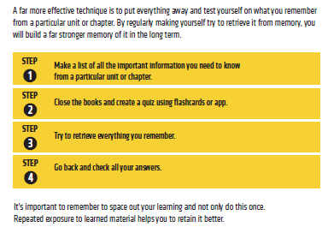
Retrieval Practice

Slide 42
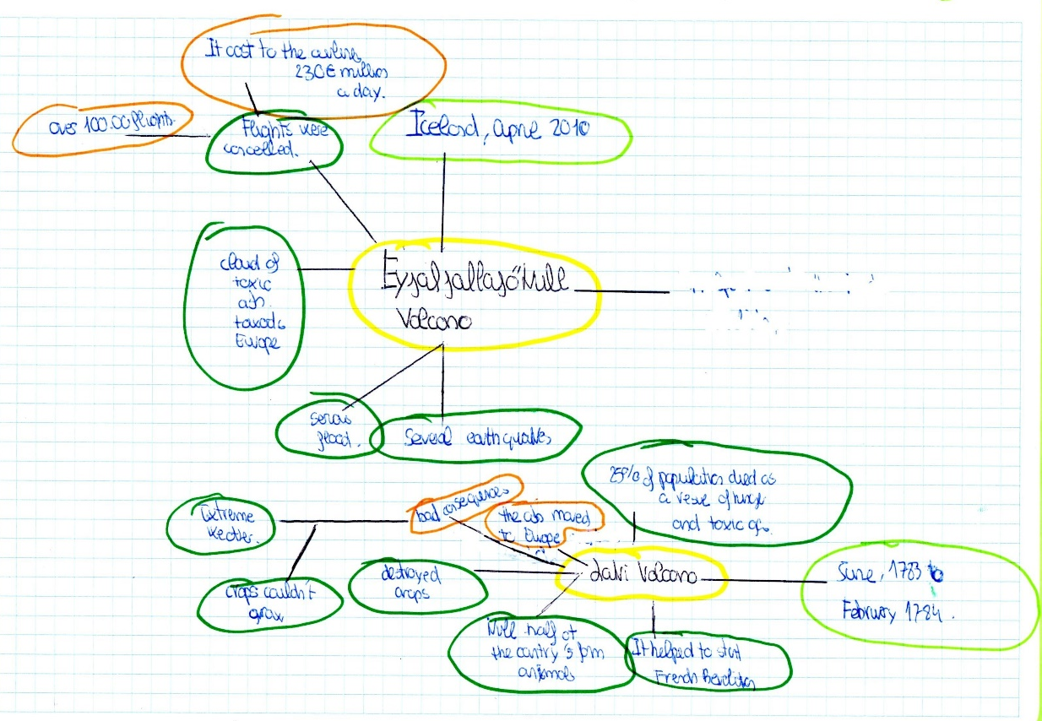
LEARN
E.G. MAKE A MIND MAP

Slide 43
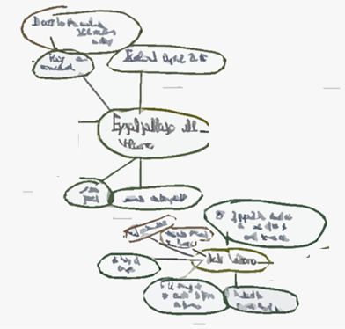
LEARN
E.G. MAKE A MIND MAP
TEST
E.G. Produce it from memory on a whiteboard

Slide 44
LEARN
E.G. MAKE A MIND MAP
TEST
E.G. Produce it from memory on a whiteboard
CHECK
E.g. Does your memory match your original learning resource

Slide 45
Questioning and Elaboration

Slide 46
Interleaving

Slide 47
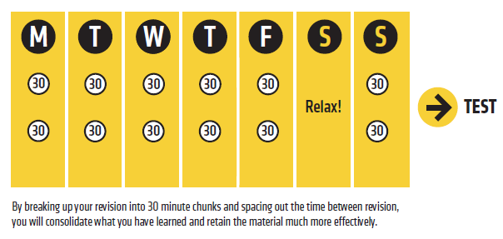
Spaced Practice

Slide 48
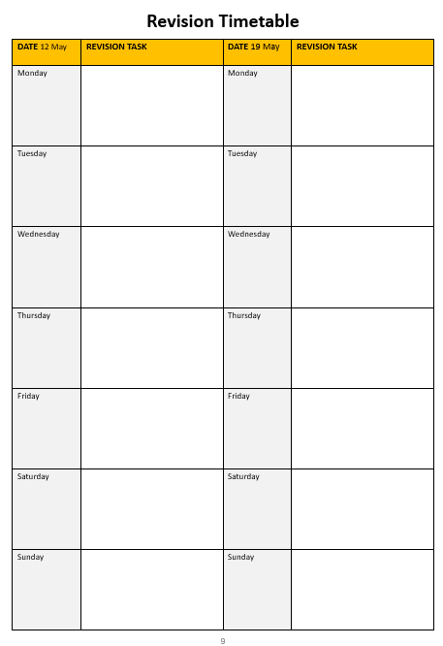
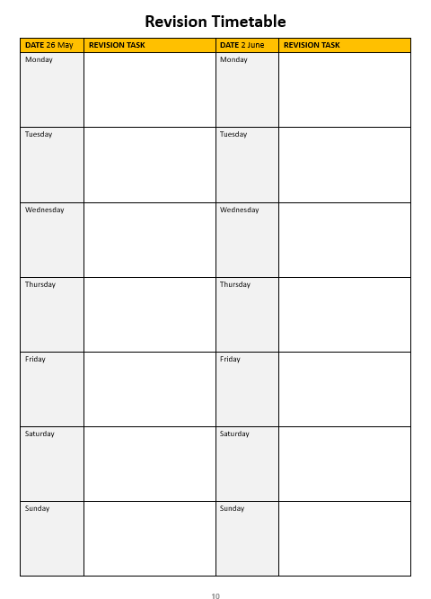
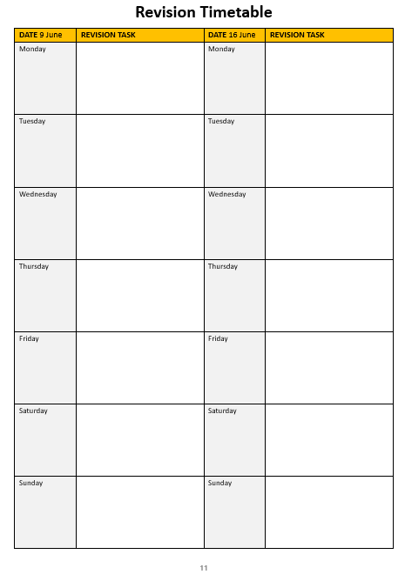

Slide 50
What is a good attendance for a student?
90% sounds like a lot! It would be a good score on a test, for example. But is it good attendance for a school student?

Slide 51
Why is attendance important?

Slide 52
What is my attendance target?
At WHS we know that there are times when students are genuinely ill, injured or have a medical condition that makes 100% attendance very challenging to achieve
We set a target of 96% attendance over the course of the academic year
If you are significantly below this (your tutor should be able to tell you), then you can set yourself the target of getting 96% attendance this half term. If you focus on each day/week, it’s an easier way of hitting your goals!

Slide 53
Attendance versus Progress – William Howard School (2024)
On average, students with attendance above 95% made half a grade better progress in each subject than an average student
On average, students with attendance above 95% made 0.75 grades better progress in each subject than all those students with attendance below 95%
Progress made compared to an average William Howard student

Slide 54
SZL BOOKLET, MOCK EXAMS, SUPPORT CONTACTS

Slide 55
Mock Exams
M | 09/06/2025
T | 10/06/2025
W | 11/06/2025 | First Exam – Maths Paper 1
T | 12/06/2025
F | 13/06/2025
M | 16/06/2025 | Exams. All GCSE subjects will have mock exams. Some subjects will have more than one paper
T | 17/06/2025
W | 18/06/2025
T | 19/06/2025
F | 20/06/2025
M | 23/06/2025
T | 24/06/2025
W | 25/06/2025
T | 26/06/2025
F | 27/06/2025
GCSE timetable will be shared before half-term.

Slide 56
Assessment Booklet

Slide 57
Sports Hall

Slide 58
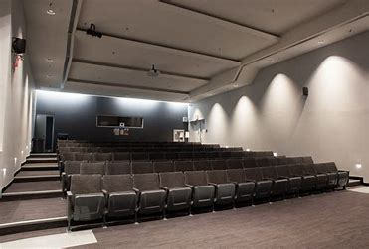
Lecture Theatre

Slide 59
Year 10 Team
Ms Ledger
sledger@williamhoward.cumbria.sch.uk
Ms Furniss
cfurniss@williamhoward.cumbria.sch.uk​

