Slide 1
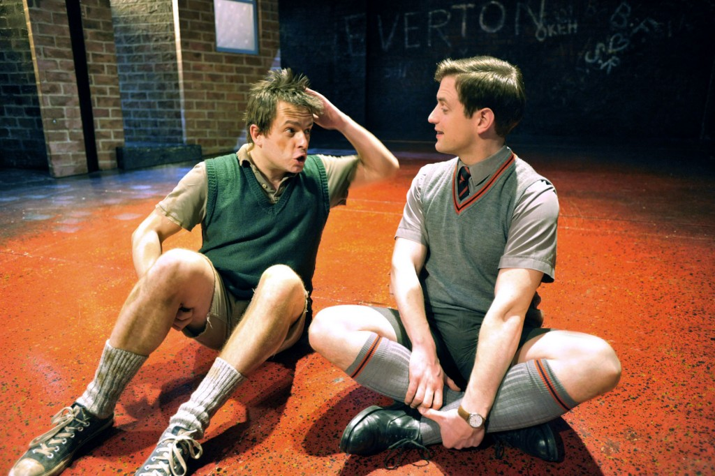
How does Russell present the character of Edward?
Intelligent
Middle class
Capitalist
Well spoken – uses
formal language
Kind
Supportive
Sensible

Slide 2
How does Russell present the character of Mickey?
Lower Class/ Working Class
Poor / Poverty stricken
Uneducated
Liverpudlian accent
Excitable
Loveable rogue
Unstable – mentally

Slide 3
What role does the omniscient narrator
have in Blood Brothers?
Omniscient
Dark/sinister/
threatening
Unusual
Foreshadowing
Foreboding
Malevolent
Influentual

Slide 4
How is Mrs Johnstone
presented throughout the play?
Working Class
Superstitious
Naïve
Beautiful
Vulnerable
Maternal
Poverty stricken

Slide 5
Explore the relationship
between Mrs Lyons and
Mrs Johnstone.
Exploitative
Manipulative
Unequal
Fearful
Disturbing
Cruel
Superstitious
Anxious

Slide 6
Well spoken
Middle class
Educated
Posh
Anxious
Manipulative
Cruel
Unkind
Cold & Calculated
How is Mrs Lyons
presented in the play?

Slide 7
What role does Sammy play?
Naïve
Antagonistic
Derailed
Uneducated
anti-social
Aggressive
Threatening
Bad influence

Slide 8
What role does Linda play?
Feisty
Strong willed
Untrustworthy
Humorous
Kind
Compassionate

Slide 9
Seven year structure
Two acts
Cyclical nature
Repeated motifs
Omniscient narrative
Foreshadowing
Musical
How does the structure of the
play promote action in
Blood Brothers?

Slide 10
Guns
Teasing
One-upmanship
Foreshadowing
Fate
Tragedy
Inevitability
Carefree
Symbolic
‘Childhood games and relationships are important in Blood Brothers
In order to foreshadow the tragic ending’
How far would you agree with this statement?

Slide 11
“Class plays an important
role in the tragic events
in Blood Brothers”
With reference to
this idea explore how
far you agree with this
statement?
Divided society
Capitalism
Disparity
Negativity
Persuasion
Threatening

