Slide 1
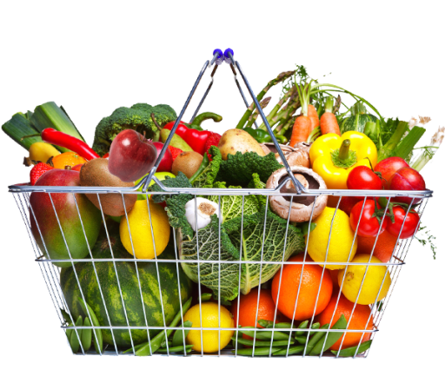
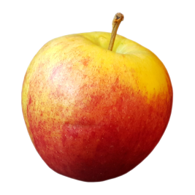
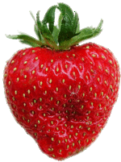
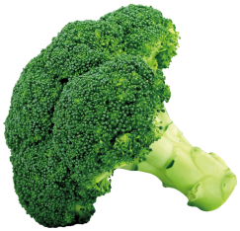
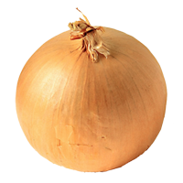
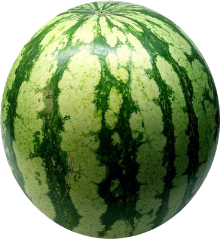
5 a day: Literature
1
List 4 ways the theme of isolation is illustrated in ACC.
What does the adjective “squiffy” mean? Who is referred to in this way? List 3 things you know about this character.
2
3
Both Dickens and Shakespeare use antithesis in their texts. Write down one quote from each text in which it is used. What is the effect in each one?
4
Identify 3 ways symbolism is used in AIC.
5
Explode the following quote to reveal as many layers of meaning as you can: “this dead butcher and his fiend-like queen”.

Slide 2
5 a day: Literature
Explode this quotation and explore at least 3 layers of meaning: “But the way some of these cranks talk and write now, you’d think everybody has to look after everybody else, as if we were all mixed up together like bees in a hive – a man has to mind his own business and look after himself…”
1
2
List 3 ways Shakespeare uses animal imagery in Macbeth. Explain the significance of each example.
3
How does Dickens use pathetic fallacy in Stave 5? Use two quotations to support your answer.
4
How does Macbeth follow the conventions of a classical Greek tragedy? List at least 4 different ways.
5
Both Dickens and Priestley focus on social responsibility. Write a summary of the different ways they explore this in their texts.

Slide 3
5 a day: Literature
1
List 3 effects of Dickens’ use of an omniscient narrator in ACC.
How are Macbeth and Banquo illustrated at the start of Macbeth? Try to use 2 quotations to support your answer.
2
3
List 4 dramatic devices used by Priestley in AIC.
What is a motif? Make some brief notes on how Shakespeare uses one of these in Macbeth.
4
5
Explode the following quote to reveal as many layers of meaning as you can: “A solitary child, neglected by his friends.”

Slide 4
5 a day: Literature
What is the purpose of Ignorance and Want in ACC? What key message does Dickens aim to send through them?
1
2
Explain the significance of one of the settings in Macbeth.
3
What is juxtaposition? Explain one way both Dickens and Shakespeare use it in their texts.
What is the significance of the following stage direction: “the lighting should be pink and intimate, until the Inspector arrives, and then it should be brighter and harder”. Consider layers of meaning.
4
5
Which two historical events does Mr Birling refer to in Act 1? What do his views on these events highlight about his character? Write down at least 3 ideas.

Slide 5
5 a day: Literature
List 4 things Inspector Goole does to maintain control over the Birlings in AIC. We can refer to this character as a dramatic device, why?
1
“The raven himself is hoarse” who says this? Bullet point 3 different interpretations of this quotation.
2
3
What is the purpose of Fred’s character in ACC? List 4 different ideas.
4
List 4 ways Priestley explores the generation gap in AIC.
5
Explode the following quote to reveal as many layers of meaning as you can: “Be innocent of the knowledge, dearest chuck, Till thou applaud the deed”

Slide 6
5 a day: Literature
“But now I an cabined, cribbed, confined.” Who says this? What does it reveal about the character at this point in the text? Explore layers of meaning.
1
2
Write down quotations about the Ghost of Christmas Past. Explain the significance of each one.
3
Why does Shakespeare sometimes switch to prose in Macbeth. Provide an example to support your answer.
4
“Genial face, its sparkling eye, its open hand, its cheery voice.” Who is being described here? What does this character represent?
5
Why did Priestley set his play in 1912? What key political beliefs are woven through his work?

