Slide 1
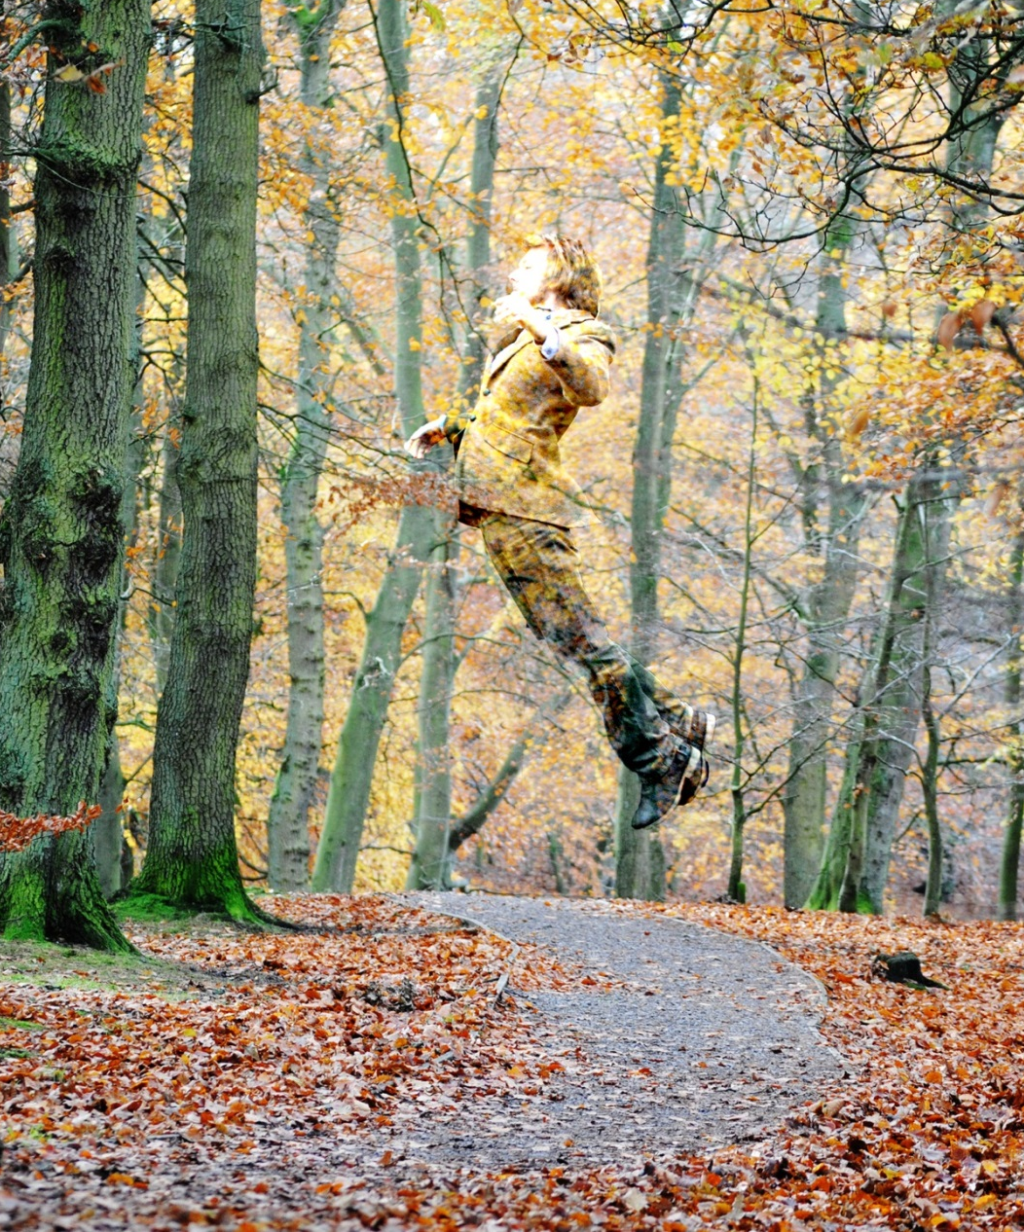
Why choose photography?
Are you creative and imaginative?
Do you enjoy exploring ideas and looking at things in different ways?
Photography is about looking, learning, thinking and communicating ideas.

Slide 2
GCSE Photography
Curriculum Road Map
KS4
Foundation/ diploma in Art and design leading to a degree
Hand in all work for final assessment
Final exam produce a final piece with no interruption – You are going to love this
Creative Apprenticeships
GCSE Examinations
40%
In-class coursework/ intervention
60%
KS5 A-Level Photography
Be in charge you are independent
Review and refine ideas- you are nearly there!!
Finalise presentation of work.
You choose the ideas materials and message you are projecting
COURSEWORK
Developing ideas further through workshops/ experimentation and introduction new photographic processes
Review plans for independent project
Outside links –trip /visit to inspire and learn new processes
Proposal – set the scene
Share ideas strong research links begin
Year 11
Implement trip into new project
Working with others through visiting photographers
Experience a mock exam
Trips /visit galleries- view work of others
Introducing and actioning independent ideas and project
Tutorial and nurture groups
COURSEWORK
Aims and
objectives
Understanding the assessment objectives
Reviewing and refining work
Managing time/ becoming independent
GCSE Business Studies
Photoshoot planning
Year 10
BTEC Enterprise
Who inspires us – learning how to research and inject ideas
COURSEWORK
Closeup, landscape, portrait, illusion, high speed are only a few style of photography covered on this course
Introduction to the course- Basic camera skills
Workshops with other photographers learning new techniques and skills
Experimenting with the camera
Exploring a range of new techniques- digital photoshop, dark room, transfer, gel transfer cyanotype, photomontage to name but a few.

Slide 3
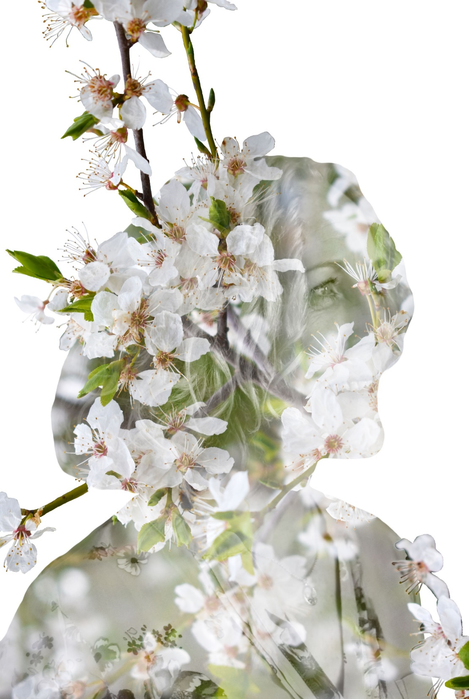
Specification::
GCSE two year course
Year one will consist of Portfolio/workshop based work.
Year two will be a personal investigation based on coursework: 60%
Exam 40%

Slide 4
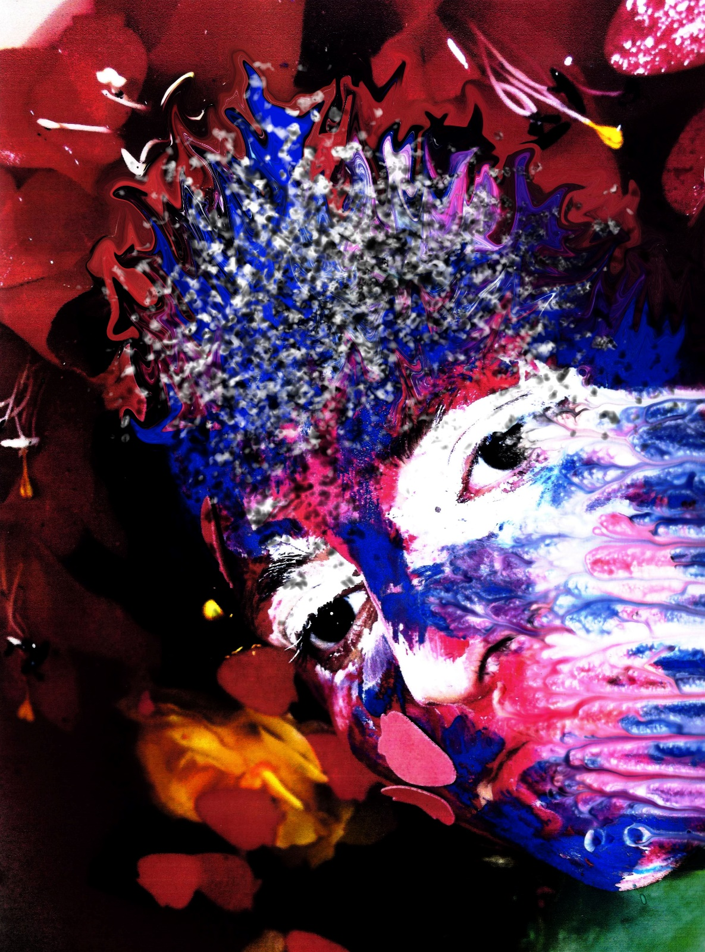
Content::
Portraiture
Landscape photography
Still life
Documentary
Photojournalism
Fashion photography
Experimental photography
Multimedia
Moving image (film and animation)

Slide 5
Experimentation
Exploring a range of new techniques
digital manipulation- photoshop
dark room
Transfer techniques
Cyanotype- tea toning
photomontage/ mixed media
To name but a few.

Slide 6
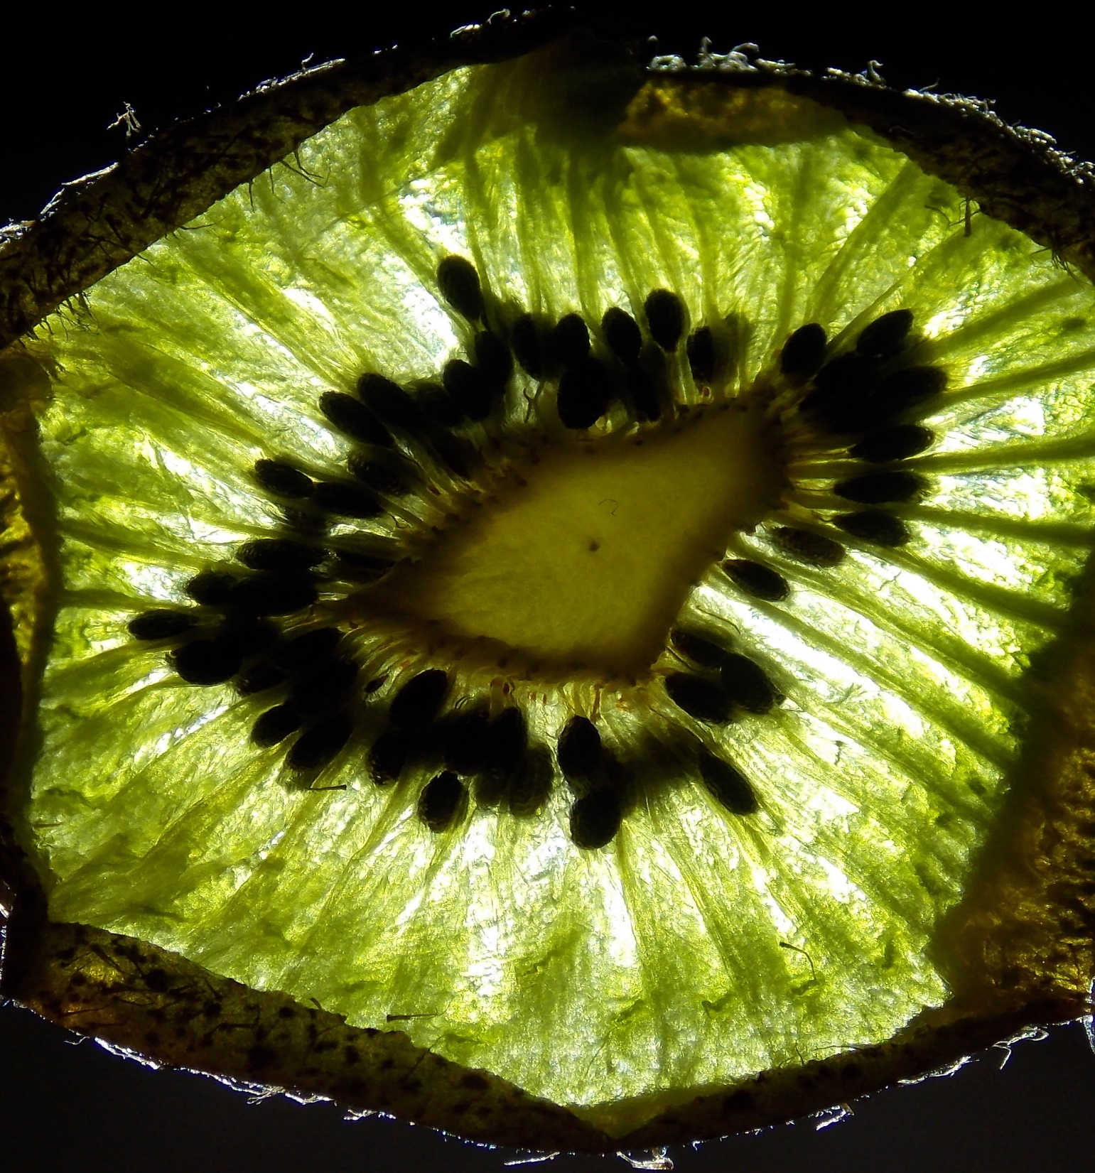

Slide 7
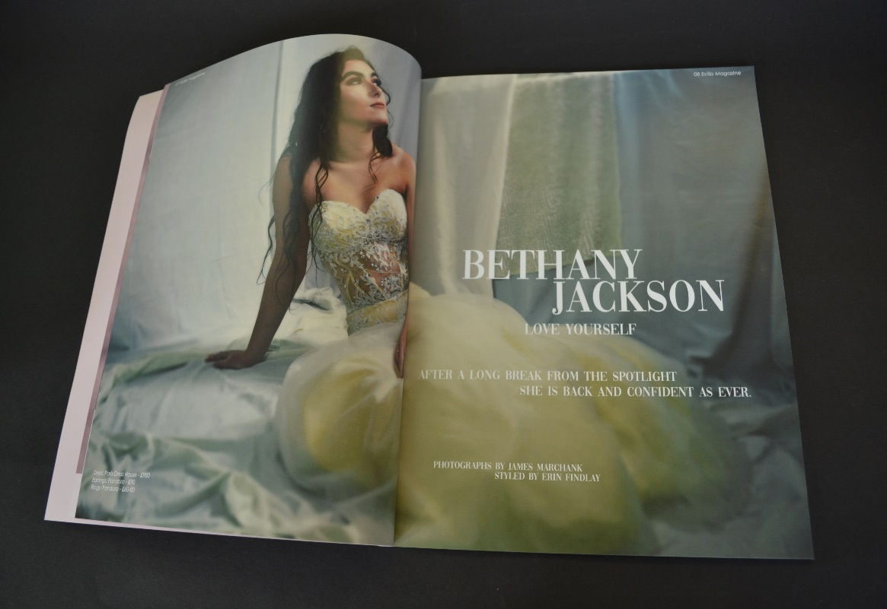
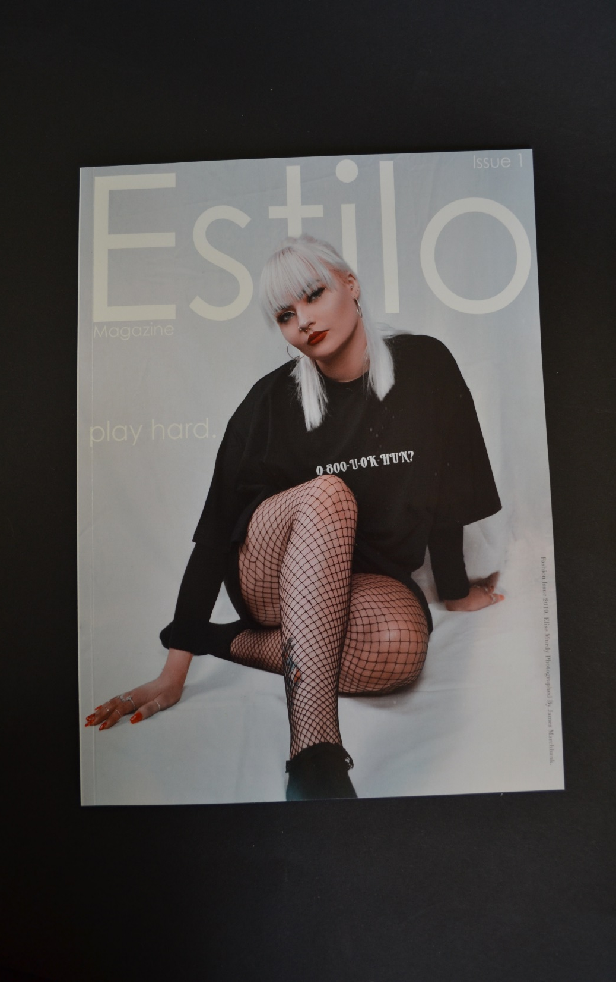
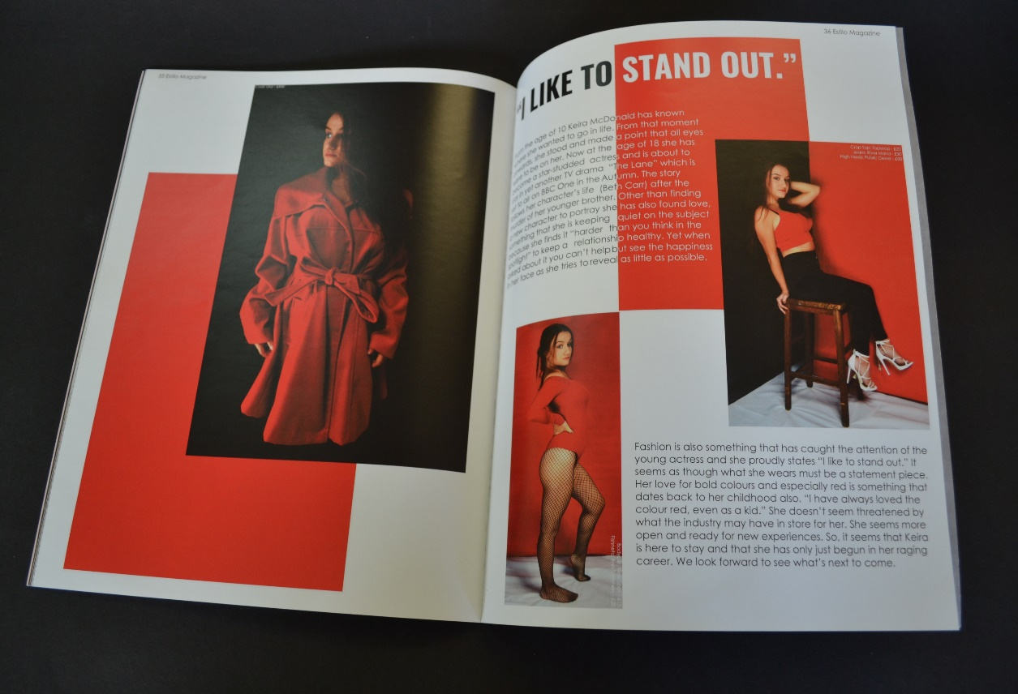

Slide 8
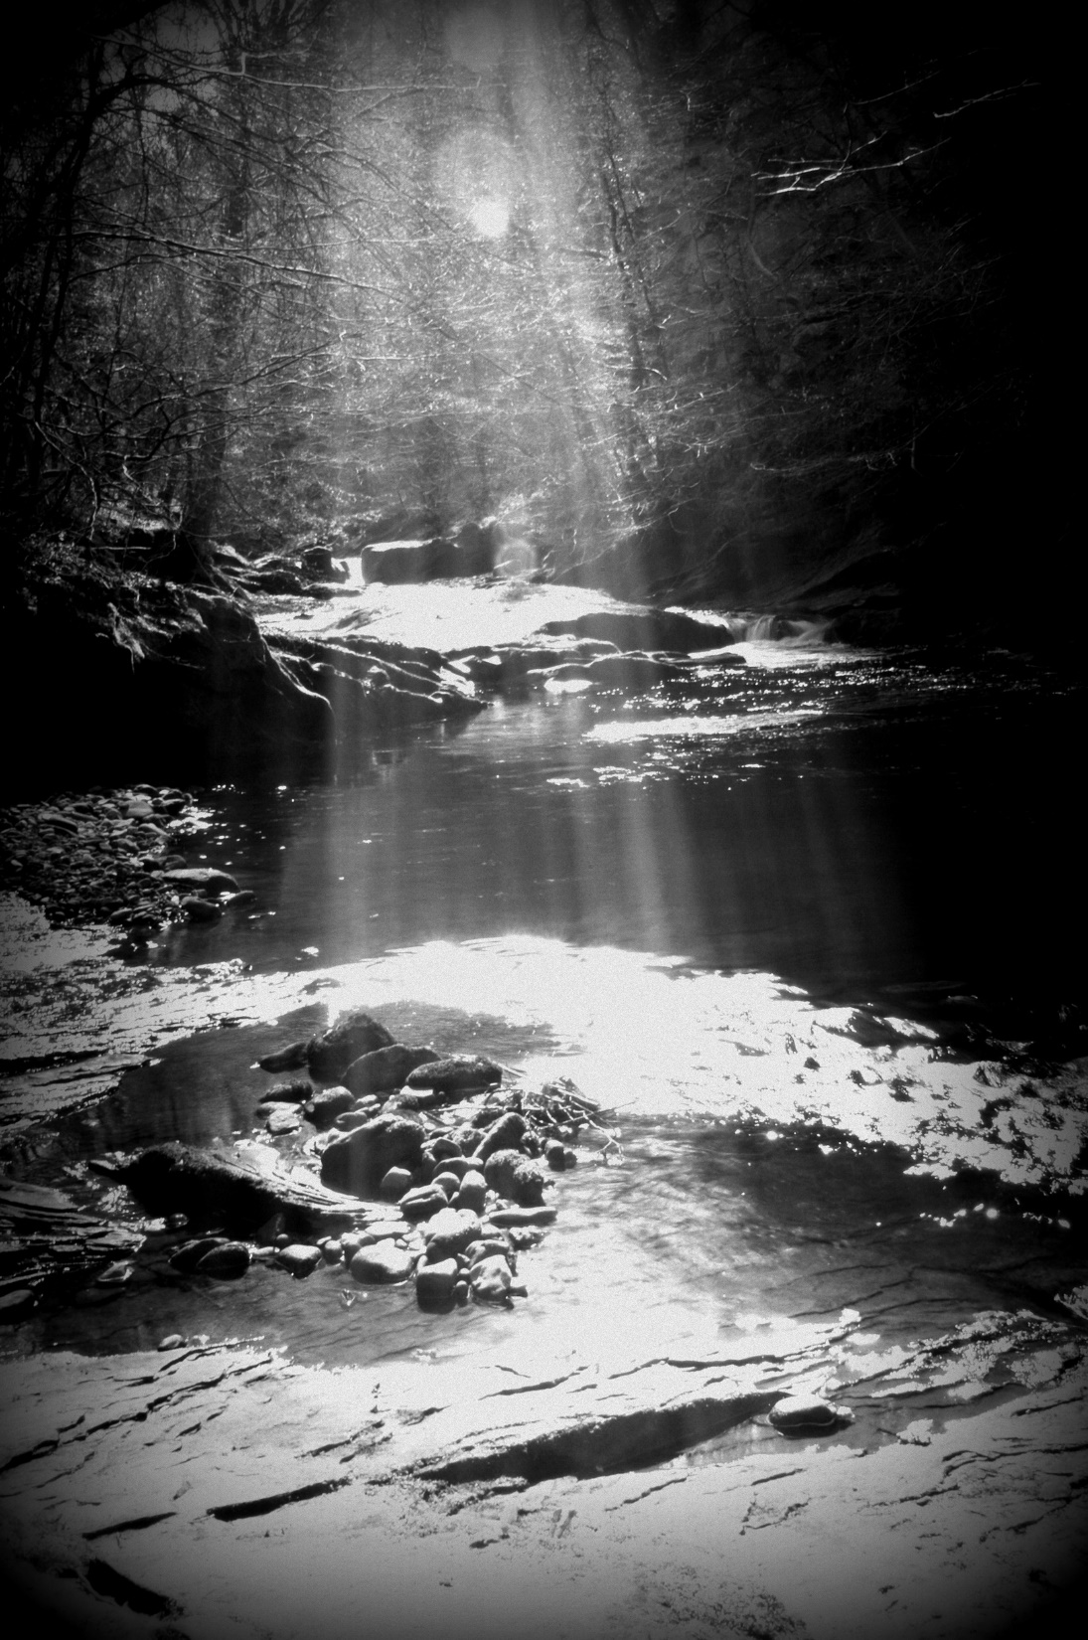
Photography is a great companion to all other subjects as creativity, imagination and problem solving skills can give you great ideas for other subjects and enable you to realise your full potential.

Slide 9
Further education
A level photography
Foundation /diploma in art and design
Degree in photography

Slide 10
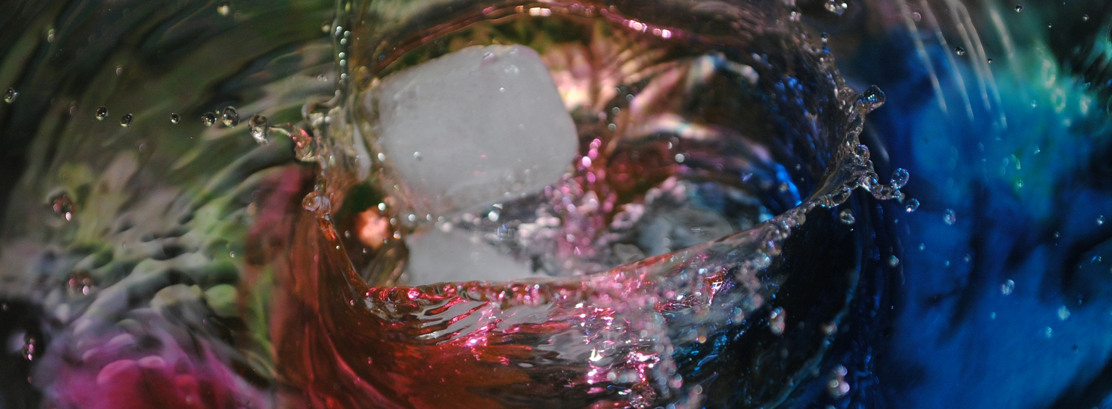
Possible career options:
Sports photographer
Photographic illustration
Animation and Graphics
Fashion photographer
Filmmaker
Forensic photography
Photojournalist
Architectural
Advertising

Slide 11
