Slide 1
English Language – Explorations in Creative Reading and Writing
Key Stage 4 – Year 11
Homework Booklet
Contents |  | Completed? (tick)
1 | Section A: The Goldfinch
2 | Section B: Outsiders
3 | Section A: The Great Gatsby
4 | Section B: Concert
5 | Section A: The Cuckoo’s Calling
6 | Section B: Police
7 | Section A: Two Old Women
8 | Section B: Journey
9 | Section A: The Duchess and the Jeweller
10 | Section B: Natural Disaster
Name______________
Class_______________

Slide 2
1. Section A: The Goldfinch
This extract is from the first chapter of a novel by Donna Tartt.
The Goldfinch
Things would have turned out better if my mother had lived. As it was, she died when I was a kid; and though everything that’s happened to me since then is thoroughly my own fault, still when I lost her I lost sight of any landmark that might have led me someplace happier, to some more populated or congenial* life.
Her death the dividing mark: Before and After. And though it’s a bleak thing to admit all these years later, still I’ve never met anyone who made me feel loved the way she did. Everything came alive in her company; she cast a charmed theatrical light about her so that to see anything through her eyes was to see it in brighter colours than ordinary – I remember a few weeks before she died, eating a late supper with her in an Italian restaurant down in the Village, and how she grasped my sleeve at the sudden, almost painful loveliness of a birthday cake with lit candles being carried in procession from the kitchen, faint circle of light wavering in across the dark ceiling and then the cake set down to blaze amidst the family, beatifying* an old lady’s face, smiles all round, waiters stepping away with their hands behind their backs – just an ordinary birthday dinner you might see anywhere in an inexpensive downtown restaurant, and I’m sure I wouldn’t even remember it had she not died so soon after, but I thought about it again and again after her death and indeed I’ll probably think about it all my life: that candlelit circle, a tableau vivant* of the daily, commonplace happiness that was lost when I lost her.
She was beautiful, too. That’s almost secondary; but still, she was. When she came to New York fresh from Kansas, she worked part-time as a model though she was too uneasy in front of the camera to be very good at it; whatever she had, it didn’t translate to film.
And yet she was wholly herself: a rarity. I cannot recall ever seeing another person who really resembled her. She had black hair, fair skin that freckled in summer, china-blue eyes with a lot of light in them; and in the slant of her cheekbones there was such an eccentric mixture of the tribal and the Celtic Twilight that sometimes people guessed she was Icelandic. In fact, she was half Irish, half Cherokee, from a town in Kansas near the Oklahoma border; and she liked to make me laugh by calling herself an Okie even though she was as glossy and nervy and stylish as a racehorse. That exotic character unfortunately comes out a little too stark and unforgiving in photographs – her freckles covered with makeup, her hair pulled back in a ponytail at the nape of her neck like some nobleman in The Tale of Genji – and what doesn’t come across at all is her warmth, her merry, unpredictable quality, which is what I loved about her most. It’s clear, from the stillness she emanates in pictures, how much she mistrusted the camera; she gives off a watchful, tigerish air of steeling herself against attack. But in life she wasn’t like that. She moved with a thrilling quickness, gestures sudden and light, always perched on the edge of her chair like some long elegant marsh-bird about to startle and fly away. I loved the sandalwood perfume she wore, rough and unexpected, and I loved the rustle of her starched shirt when she swooped down to kiss me on the forehead. And her laugh was enough to make you want to kick over what you were doing and follow her down the street. Wherever she went, men looked at her out of the corner of their eyes, and sometimes they used to look at her in a way that bothered me a little.
*Glossary
congenial = pleasant
beatifying = blessing, making saintly
tableau vivant = a living picture/painting

Slide 3
Section A: Reading
Answer all questions in this section.
You are advised to spend about 45 minutes on this section.
Q1. Read again the first part of the Source from lines 1 to 6.
List four things from this part of the text about the narrator.
[4 marks]
1._____________________________________________________________________________________________________________________________________________
2._____________________________________________________________________________________________________________________________________________
3._____________________________________________________________________________________________________________________________________________
4._____________________________________________________________________________________________________________________________________________
Q2. Look in detail at this extract from lines 5 to 20 of the Source:
Her death the dividing mark: Before and After. And though it’s a bleak thing to admit all these years later, still I’ve never met anyone who made me feel loved the way she did. Everything came alive in her company; she cast a charmed theatrical light about her so that to see anything through her eyes was to see it in brighter colours than ordinary – I remember a few weeks before she died, eating a late supper with her in an Italian restaurant down in the Village, and how she grasped my sleeve at the sudden, almost painful loveliness of a birthday cake with lit candles being carried in procession from the kitchen, faint circle of light wavering in across the dark ceiling and then the cake set down to blaze amidst the family, beatifying* an old lady’s face, smiles all round, waiters stepping away with their hands behind their backs – just an ordinary birthday dinner you might see anywhere in an inexpensive downtown restaurant, and I’m sure I wouldn’t even remember it had she not died so soon after, but I thought about it again and again after her death and indeed I’ll probably think about it all my life: that candlelit circle, a tableau vivant* of the daily, commonplace happiness that was lost when I lost her.
She was beautiful, too. That’s almost secondary; but still, she was. When she came to New York fresh from Kansas, she worked part-time as a model though she was too uneasy in front of the camera to be very good at it; whatever she had, it didn’t translate to film.
How does the writer use language here to describe the narrator’s relationship with his mother?
You could include the writer’s choice of:
•words and phrases
•language features and techniques
•sentence forms
[8 marks]

Slide 4
Q3. You now need to think about the whole of the Source.
This extract comes from the opening chapter of the novel.
How has the writer structured the text to interest you as a reader?
You could write about:
•what the writer focuses your attention on at the beginning
•how and why the writer changes this focus as the Source develops
•any other structural features that interest you
[8 marks]
Q4. Focus this part of your answer on the second part of the Source from line 18 to the end.
A student, having read this section of the text, said: ‘The description is so vivid that the character of the mother really seems to come to life.’
To what extent do you agree?
In your response, you could:
•write about your own impressions of the mother
•evaluate how the writer has created these impressions
•support your opinions with references to the text
[20 marks]

Slide 5
Responses:
______________________________________________________________________________________________________________________________________________________________________________________________________________________________________________________________________________________________________________________________________________________________________________________________________________________________________________________________________________________________________________________________________________________________________________________________________________________________________________________________________________________________________________________________________________________________________________________________________________________________________________________________________________________________________________________________________________________________________________________________________________________________________________________________________________________________________________________________________________________________________________________________________________________________________________________________________________________________________________________________________________________________________________________________________________________________________________________________________________________________________________________________________________________________________________________________________________________________________________________________________________________________________________________________________________________________________________________________________________________________________________________________________________________________________________________________________________________________________________________________________________________________________________________________________________________________________________________________________________________________________________________________________________________________________________________________________________________________________________________________________________________________________________________________________________________________________________________________________________________________________________________________________________________________________________________________

Slide 6
________________________________________________________________________________________________________________________________________________________________________________________________________________________________________________________________________________________________________________________________________________________________________________________________________________________________________________________________________________________________________________________________________________________________________________________________________________________________________________________________________________________________________________________________________________________________________________________________________________________________________________________________________________________________________________________________________________________________________________________________________________________________________________________________________________________________________________________________________________________________________________________________________________________________________________________________________________________________________________________________________________________________________________________________________________________________________________________________________________________________________________________________________________________________________________________________________________________________________________________________________________________________________________________________________________________________________________________________________________________________________________________________________________________________________________________________________________________________________________________________________________________________________________________________________________________________________________________________________________________________________________________________________________________________________________________________________________________________________________________________________________________________________________________________________________________________________________________________________________________________________________________________________________________________________________________________________________________________________________________

Slide 7
________________________________________________________________________________________________________________________________________________________________________________________________________________________________________________________________________________________________________________________________________________________________________________________________________________________________________________________________________________________________________________________________________________________________________________________________________________________________________________________________________________________________________________________________________________________________________________________________________________________________________________________________________________________________________________________________________________________________________________________________________________________________________________________________________________________________________________________________________________________________________________________________________________________________________________________________________________________________________________________________________________________________________________________________________________________________________________________________________________________________________________________________________________________________________________________________________________________________________________________________________________________________________________________________________________________________________________________________________________________________________________________________________________________________________________________________________________________________________________________________________________________________________________________________________________________________________________________________________________________________________________________________________________________________________________________________________________________________________________________________________________________________________________________________________________________________________________________________________________________________________________________________________________________________________________________________________________________________________________________

Slide 8
________________________________________________________________________________________________________________________________________________________________________________________________________________________________________________________________________________________________________________________________________________________________________________________________________________________________________________________________________________________________________________________________________________________________________________________________________________________________________________________________________________________________________________________________________________________________________________________________________________________________________________________________________________________________________________________________________________________________________________________________________________________________________________________________________________________________________________________________________________________________________________________________________________________________________________________________________________________________________________________________________________________________________________________________________________________________________________________________________________________________________________________________________________________________________________________________________________________________________________________________________________________________________________________________________________________________________________________________________________________________________________________________________________________________________________________________________________________________________________________________________________________________________________________________________________________________________________________________________________________________________________________________________________________________________________________________________________________________________________________________________________________________________________________________________________________________________________________________________________________________________________________________________________________________________________________________________________________________________________________

Slide 9
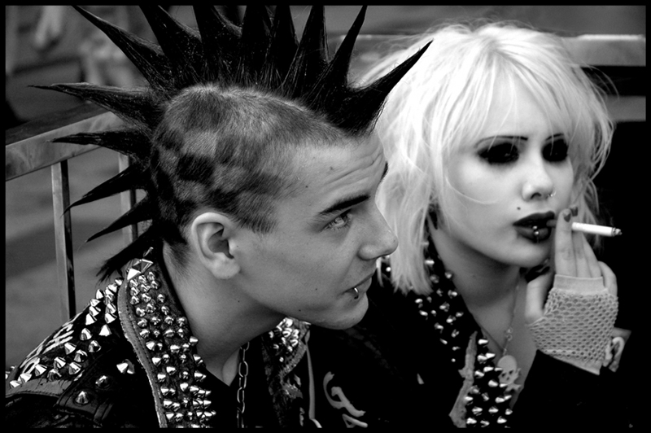
2. Section B: Outsiders
Section B: Writing
You are advised to spend about 45 minutes on this section.
Write in full sentences.
You are reminded of the need to plan your answer.
You should leave enough time to check your work at the end.
Q5. Either: Write a description suggested by this picture:
Or: Write the opening of a story with the title ‘The Outsider’.
(24 marks for content and organisation
16 marks for technical accuracy)
[40 marks]
Plan:

Slide 10
Responses:
______________________________________________________________________________________________________________________________________________________________________________________________________________________________________________________________________________________________________________________________________________________________________________________________________________________________________________________________________________________________________________________________________________________________________________________________________________________________________________________________________________________________________________________________________________________________________________________________________________________________________________________________________________________________________________________________________________________________________________________________________________________________________________________________________________________________________________________________________________________________________________________________________________________________________________________________________________________________________________________________________________________________________________________________________________________________________________________________________________________________________________________________________________________________________________________________________________________________________________________________________________________________________________________________________________________________________________________________________________________________________________________________________________________________________________________________________________________________________________________________________________________________________________________________________________________________________________________________________________________________________________________________________________________________________________________________________________________________________________________________________________________________________________________________________________________________________________________________________________________________________________________________________________________________________________________________

Slide 11
________________________________________________________________________________________________________________________________________________________________________________________________________________________________________________________________________________________________________________________________________________________________________________________________________________________________________________________________________________________________________________________________________________________________________________________________________________________________________________________________________________________________________________________________________________________________________________________________________________________________________________________________________________________________________________________________________________________________________________________________________________________________________________________________________________________________________________________________________________________________________________________________________________________________________________________________________________________________________________________________________________________________________________________________________________________________________________________________________________________________________________________________________________________________________________________________________________________________________________________________________________________________________________________________________________________________________________________________________________________________________________________________________________________________________________________________________________________________________________________________________________________________________________________________________________________________________________________________________________________________________________________________________________________________________________________________________________________________________________________________________________________________________________________________________________________________________________________________________________________________________________________________________________________________________________________________________________________________________________________

Slide 12
________________________________________________________________________________________________________________________________________________________________________________________________________________________________________________________________________________________________________________________________________________________________________________________________________________________________________________________________________________________________________________________________________________________________________________________________________________________________________________________________________________________________________________________________________________________________________________________________________________________________________________________________________________________________________________________________________________________________________________________________________________________________________________________________________________________________________________________________________________________________________________________________________________________________________________________________________________________________________________________________________________________________________________________________________________________________________________________________________________________________________________________________________________________________________________________________________________________________________________________________________________________________________________________________________________________________________________________________________________________________________________________________________________________________________________________________________________________________________________________________________________________________________________________________________________________________________________________________________________________________________________________________________________________________________________________________________________________________________________________________________________________________________________________________________________________________________________________________________________________________________________________________________________________________________________________________________________________________________________________

Slide 13
3. Section A: The Great Gatsby
This extract is from a novel by F Scott Fitzgerald. In this section the narrator describes the extravagant parties held by his rich neighbour.
The Great Gatsby
There was music from my neighbor's house through the summer nights. In his blue gardens men and girls came and went like moths among the whisperings and the champagne and the stars. At high tide in the afternoon I watched his guests diving from the tower of his raft or taking the sun on the hot sand of his beach while his two motor-boats slit the waters of the Sound, drawing aquaplanes over cataracts of foam. On week-ends his Rolls-Royce became an omnibus, bearing parties to and from the city, between nine in the morning and long past midnight, while his station wagon* scampered like a brisk yellow bug to meet all trains. And on Mondays eight servants including an extra gardener toiled all day with mops and scrubbing-brushes and hammers and garden-shears, repairing the ravages of the night before.
Every Friday five crates of oranges and lemons arrived from a fruiterer in New York—every Monday these same oranges and lemons left his back door in a pyramid of pulpless halves. There was a machine in the kitchen which could extract the juice of two hundred oranges in half an hour, if a little button was pressed two hundred times by a butler’s thumb.
At least once a fortnight a corps of caterers came down with several hundred feet of canvas and enough colored lights to make a Christmas tree of Gatsby’s enormous garden. On buffet tables, garnished with glistening hors-d’oeuvre*, spiced baked hams crowded against salads of harlequin designs and pastry pigs and turkeys bewitched to a dark gold. In the main hall a bar with a real brass rail was set up, and stocked with gins and liquors and with cordials so long forgotten that most of his female guests were too young to know one from another.
By seven o’clock the orchestra has arrived—no thin five-piece affair but a whole pitful of oboes and trombones and saxophones and viols and cornets and piccolos and low and high drums. The last swimmers have come in from the beach now and are dressing upstairs; the cars from New York are parked five deep in the drive, and already the halls and salons and verandas are gaudy with primary colors and hair shorn in strange new ways and shawls beyond the dreams of Castile. The bar is in full swing and floating rounds of cocktails permeate the garden outside until the air is alive with chatter and laughter and casual innuendo and introductions forgotten on the spot and enthusiastic meetings between women who never knew each other’s names.
The lights grow brighter as the earth lurches away from the sun and now the orchestra is playing yellow cocktail music and the opera of voices pitches a key higher. Laughter is easier, minute by minute, spilled with prodigality*, tipped out at a cheerful word. The groups change more swiftly, swell with new arrivals, dissolve and form in the same breath—already there are wanderers, confident girls who weave here and there among the stouter and more stable, become for a sharp, joyous moment the center of a group and then excited with triumph glide on through the sea-change of faces and voices and color under the constantly changing light.
Suddenly one of these gypsies in trembling opal, seizes a cocktail out of the air, dumps it down for courage and moving her hands like Frisco dances out alone on the canvas platform. A momentary hush; the orchestra leader varies his rhythm obligingly for her and there is a burst of chatter as the erroneous news goes around that she is Gilda Gray's understudy from the "Follies." The party has begun.
*Glossary
station wagon = an estate car
hors-d’oeuvre = a small portion of food served as an appetizer before a main meal
prodigality = wasteful luxury

Slide 14
Section A: Reading
Answer all questions in this section.
You are advised to spend about 45 minutes on this section.
Q1. Read again the first part of the Source from lines 1 to 8.
List four things from this part of the text about what goes on at the neighbour’s house.
[4 marks]
1.________________________________________________________________________________________________________________________________________________________
2.________________________________________________________________________________________________________________________________________________________
3.________________________________________________________________________________________________________________________________________________________
4.________________________________________________________________________________________________________________________________________________________
Q2. Look in detail at this extract from lines 1 to 18 of the Source:
There was music from my neighbor's house through the summer nights. In his blue gardens men and girls came and went like moths among the whisperings and the champagne and the stars. At high tide in the afternoon I watched his guests diving from the tower of his raft or taking the sun on the hot sand of his beach while his two motor-boats slit the waters of the Sound, drawing aquaplanes over cataracts of foam. On week-ends his Rolls-Royce became an omnibus, bearing parties to and from the city, between nine in the morning and long past midnight, while his station wagon scampered like a brisk yellow bug to meet all trains. And on Mondays eight servants including an extra gardener toiled all day with mops and scrubbing-brushes and hammers and garden-shears, repairing the ravages of the night before.
Every Friday five crates of oranges and lemons arrived from a fruiterer in New York—every Monday these same oranges and lemons left his back door in a pyramid of pulpless halves. There was a machine in the kitchen which could extract the juice of two hundred oranges in half an hour, if a little button was pressed two hundred times by a butler’s thumb.
At least once a fortnight a corps of caterers came down with several hundred feet of canvas and enough colored lights to make a Christmas tree of Gatsby’s enormous garden. On buffet tables, garnished with glistening hors-d’oeuvre, spiced baked hams crowded against salads of harlequin designs and pastry pigs and turkeys bewitched to a dark gold. In the main hall a bar with a real brass rail was set up, and stocked with gins and liquors and with cordials so long forgotten that most of his female guests were too young to know one from another.
How does the writer use language here to describe the extravagance of the parties?
You could include the writer’s choice of:
•words and phrases
•language features and techniques
•sentence forms
[8 marks]

Slide 15
Q3. You now need to think about the whole of the Source.
This extract comes from the opening chapter of the novel.
How has the writer structured the text to interest you as a reader?
You could write about:
•what the writer focuses your attention on at the beginning
•how and why the writer changes this focus as the Source develops
•any other structural features that interest you
[8 marks]
Q4. Focus this part of your answer on the second part of the Source from line 19 to the end.
A student, having read this section of the text, said: ‘The writer brings the parties to life for the reader. It is as if you are there.’
To what extent do you agree?
In your response, you could:
•write about your own impressions of the parties
•evaluate how the writer has created these impressions
•support your opinions with references to the text
[20 marks]

Slide 16
Responses:
______________________________________________________________________________________________________________________________________________________________________________________________________________________________________________________________________________________________________________________________________________________________________________________________________________________________________________________________________________________________________________________________________________________________________________________________________________________________________________________________________________________________________________________________________________________________________________________________________________________________________________________________________________________________________________________________________________________________________________________________________________________________________________________________________________________________________________________________________________________________________________________________________________________________________________________________________________________________________________________________________________________________________________________________________________________________________________________________________________________________________________________________________________________________________________________________________________________________________________________________________________________________________________________________________________________________________________________________________________________________________________________________________________________________________________________________________________________________________________________________________________________________________________________________________________________________________________________________________________________________________________________________________________________________________________________________________________________________________________________________________________________________________________________________________________________________________________________________________________________________________________________________________________________________________________________________

Slide 17
________________________________________________________________________________________________________________________________________________________________________________________________________________________________________________________________________________________________________________________________________________________________________________________________________________________________________________________________________________________________________________________________________________________________________________________________________________________________________________________________________________________________________________________________________________________________________________________________________________________________________________________________________________________________________________________________________________________________________________________________________________________________________________________________________________________________________________________________________________________________________________________________________________________________________________________________________________________________________________________________________________________________________________________________________________________________________________________________________________________________________________________________________________________________________________________________________________________________________________________________________________________________________________________________________________________________________________________________________________________________________________________________________________________________________________________________________________________________________________________________________________________________________________________________________________________________________________________________________________________________________________________________________________________________________________________________________________________________________________________________________________________________________________________________________________________________________________________________________________________________________________________________________________________________________________________________________________________________________________________

Slide 18
________________________________________________________________________________________________________________________________________________________________________________________________________________________________________________________________________________________________________________________________________________________________________________________________________________________________________________________________________________________________________________________________________________________________________________________________________________________________________________________________________________________________________________________________________________________________________________________________________________________________________________________________________________________________________________________________________________________________________________________________________________________________________________________________________________________________________________________________________________________________________________________________________________________________________________________________________________________________________________________________________________________________________________________________________________________________________________________________________________________________________________________________________________________________________________________________________________________________________________________________________________________________________________________________________________________________________________________________________________________________________________________________________________________________________________________________________________________________________________________________________________________________________________________________________________________________________________________________________________________________________________________________________________________________________________________________________________________________________________________________________________________________________________________________________________________________________________________________________________________________________________________________________________________________________________________________________________________________________________________

Slide 19
________________________________________________________________________________________________________________________________________________________________________________________________________________________________________________________________________________________________________________________________________________________________________________________________________________________________________________________________________________________________________________________________________________________________________________________________________________________________________________________________________________________________________________________________________________________________________________________________________________________________________________________________________________________________________________________________________________________________________________________________________________________________________________________________________________________________________________________________________________________________________________________________________________________________________________________________________________________________________________________________________________________________________________________________________________________________________________________________________________________________________________________________________________________________________________________________________________________________________________________________________________________________________________________________________________________________________________________________________________________________________________________________________________________________________________________________________________________________________________________________________________________________________________________________________________________________________________________________________________________________________________________________________________________________________________________________________________________________________________________________________________________________________________________________________________________________________________________________________________________________________________________________________________________________________________________________________________________________________________________

Slide 20
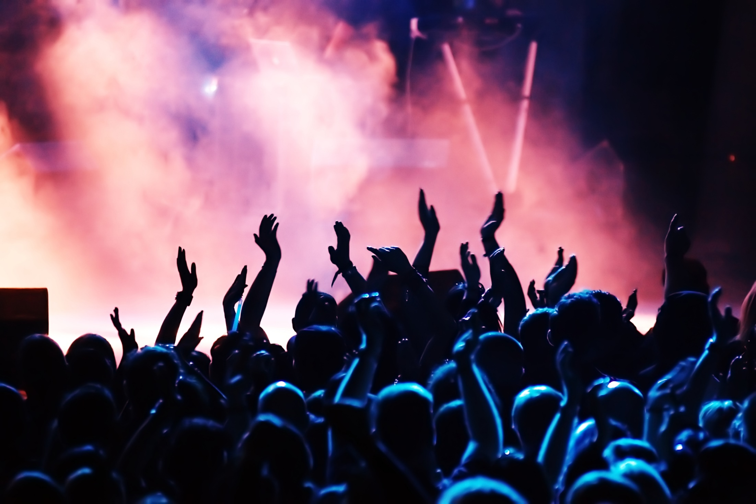
4. Section B: Concert
Section B: Writing
You are advised to spend about 45 minutes on this section.
Write in full sentences.
You are reminded of the need to plan your answer.
You should leave enough time to check your work at the end.
Q5. Either: Write a description suggested by this picture:
Or: Write a story opening for a genre of your choice. Set the scene vividly.
(24 marks for content and organisation
16 marks for technical accuracy)
[40 marks]
Plan:

Slide 21
Responses:
______________________________________________________________________________________________________________________________________________________________________________________________________________________________________________________________________________________________________________________________________________________________________________________________________________________________________________________________________________________________________________________________________________________________________________________________________________________________________________________________________________________________________________________________________________________________________________________________________________________________________________________________________________________________________________________________________________________________________________________________________________________________________________________________________________________________________________________________________________________________________________________________________________________________________________________________________________________________________________________________________________________________________________________________________________________________________________________________________________________________________________________________________________________________________________________________________________________________________________________________________________________________________________________________________________________________________________________________________________________________________________________________________________________________________________________________________________________________________________________________________________________________________________________________________________________________________________________________________________________________________________________________________________________________________________________________________________________________________________________________________________________________________________________________________________________________________________________________________________________________________________________________________________________________________________________________

Slide 22
________________________________________________________________________________________________________________________________________________________________________________________________________________________________________________________________________________________________________________________________________________________________________________________________________________________________________________________________________________________________________________________________________________________________________________________________________________________________________________________________________________________________________________________________________________________________________________________________________________________________________________________________________________________________________________________________________________________________________________________________________________________________________________________________________________________________________________________________________________________________________________________________________________________________________________________________________________________________________________________________________________________________________________________________________________________________________________________________________________________________________________________________________________________________________________________________________________________________________________________________________________________________________________________________________________________________________________________________________________________________________________________________________________________________________________________________________________________________________________________________________________________________________________________________________________________________________________________________________________________________________________________________________________________________________________________________________________________________________________________________________________________________________________________________________________________________________________________________________________________________________________________________________________________________________________________________________________________________________________________

Slide 23
________________________________________________________________________________________________________________________________________________________________________________________________________________________________________________________________________________________________________________________________________________________________________________________________________________________________________________________________________________________________________________________________________________________________________________________________________________________________________________________________________________________________________________________________________________________________________________________________________________________________________________________________________________________________________________________________________________________________________________________________________________________________________________________________________________________________________________________________________________________________________________________________________________________________________________________________________________________________________________________________________________________________________________________________________________________________________________________________________________________________________________________________________________________________________________________________________________________________________________________________________________________________________________________________________________________________________________________________________________________________________________________________________________________________________________________________________________________________________________________________________________________________________________________________________________________________________________________________________________________________________________________________________________________________________________________________________________________________________________________________________________________________________________________________________________________________________________________________________________________________________________________________________________________________________________________________________________________________________________________

Slide 24
5. Section A: The Cuckoo’s Calling
This extract is from the opening of a novel by Robert Galbraith (JK Rowling).
The Cuckoo’s Calling
The buzz in the street was like the humming of flies. Photographers stood massed behind barriers patrolled by police, their long-snouted cameras poised, their breath rising like steam. Snow fell steadily on to hats and shoulders; gloved fingers wiped lenses clear. From time to time there came outbreaks of desultory* clicking, as the watchers filled the waiting time by snapping the white canvas tent in the middle of the road, the entrance to the tall red-brick apartment block behind it, and the balcony on the top floor from which the body had fallen.
Behind the tightly packed paparazzi stood white vans with enormous satellite dishes on the roofs, and journalists talking, some in foreign languages, while soundmen in headphones hovered. Between recordings, the reporters stamped their feet and warmed their hands on hot beakers of coffee from the teeming café a few streets away. To fill the time, the woolly-hatted cameramen filmed the backs of the photographers, the balcony, the tent concealing the body, then repositioned themselves for wide shots that encompassed the chaos that had exploded inside the sedate and snowy Mayfair street, with its lines of glossy black doors framed by white stone porticos and flanked by topiary shrubs. The entrance to number 18 was bounded with tape. Police officials, some of them white-clothed forensic experts, could be glimpsed in the hallway beyond.
The television stations had already had the news for several hours. Members of the public were crowding at either end of the road, held at bay by more police; some had come, on purpose, to look, others had paused on their way to work. Many held mobile telephones aloft to take pictures before moving on. One young man, not knowing which was the crucial balcony, photographed each of them in turn, even though the middle one was packed with a row of shrubs, three neat, leafy orbs, which barely left room for a human being.
A group of young girls had brought flowers, and were filmed handing them to the police, who as yet had not decided on a place for them, but laid them self-consciously in the back of the police van, aware of camera lenses following their every move.
The correspondents sent by twenty-four-hour news channels kept up a steady stream of comment and speculation around the few sensational facts they knew.
"...from her penthouse apartment at around two o'clock this morning. Police were alerted by the building's security guard...“
"...no sign yet that they are moving the body, which has led some to speculate...“
"...no word on whether she was alone when she fell...“
"...teams have entered the building and will be conducting a thorough search."
*Glossary
desultory = aimless, half-hearted

Slide 25
Section A: Reading
Answer all questions in this section.
You are advised to spend about 45 minutes on this section.
Q1. Read again the first part of the Source from lines 1 to 6.
List four things from this part of the text about the scene in the street.
[4 marks]
1.________________________________________________________________________________________________________________________________________________________
2.________________________________________________________________________________________________________________________________________________________
3.________________________________________________________________________________________________________________________________________________________
4.________________________________________________________________________________________________________________________________________________________
Q2. Look in detail at this extract from lines 9 to 24 of the Source:
Between recordings, the reporters stamped their feet and warmed their hands on hot beakers of coffee from the teeming café a few streets away. To fill the time, the woolly-hatted cameramen filmed the backs of the photographers, the balcony, the tent concealing the body, then repositioned themselves for wide shots that encompassed the chaos that had exploded inside the sedate and snowy Mayfair street, with its lines of glossy black doors framed by white stone porticos and flanked by topiary shrubs. The entrance to number 18 was bounded with tape. Police officials, some of them white-clothed forensic experts, could be glimpsed in the hallway beyond.
The television stations had already had the news for several hours. Members of the public were crowding at either end of the road, held at bay by more police; some had come, on purpose, to look, others had paused on their way to work. Many held mobile telephones aloft to take pictures before moving on. One young man, not knowing which was the crucial balcony, photographed each of them in turn, even though the middle one was packed with a row of shrubs, three neat, leafy orbs, which barely left room for a human being.
A group of young girls had brought flowers, and were filmed handing them to the police, who as yet had not decided on a place for them, but laid them self-consciously in the back of the police van, aware of camera lenses following their every move.
How does the writer use language here to give a sense of different people’s reactions to the crime scene?
You could include the writer’s choice of:
•words and phrases
•language features and techniques
•sentence forms
[8 marks]

Slide 26
Q3. You now need to think about the whole of the Source.
This extract comes from the opening chapter of the novel.
How has the writer structured the text to interest you as a reader?
You could write about:
•what the writer focuses your attention on at the beginning
•how and why the writer changes this focus as the Source develops
•any other structural features that interest you
[8 marks]
Q4. Focus this part of your answer on the second part of the Source from line 16 to the end.
A student, having read this section of the text, said: ‘The writer makes the reader feel just as confused as the people in the scene.’
To what extent do you agree?
In your response, you could:
•write about your own impressions of what is happening in this section
•evaluate how the writer has created these impressions
•support your opinions with references to the text
[20 marks]

Slide 27
Responses:
______________________________________________________________________________________________________________________________________________________________________________________________________________________________________________________________________________________________________________________________________________________________________________________________________________________________________________________________________________________________________________________________________________________________________________________________________________________________________________________________________________________________________________________________________________________________________________________________________________________________________________________________________________________________________________________________________________________________________________________________________________________________________________________________________________________________________________________________________________________________________________________________________________________________________________________________________________________________________________________________________________________________________________________________________________________________________________________________________________________________________________________________________________________________________________________________________________________________________________________________________________________________________________________________________________________________________________________________________________________________________________________________________________________________________________________________________________________________________________________________________________________________________________________________________________________________________________________________________________________________________________________________________________________________________________________________________________________________________________________________________________________________________________________________________________________________________________________________________________________________________________________________________________________________________________________________

Slide 28
________________________________________________________________________________________________________________________________________________________________________________________________________________________________________________________________________________________________________________________________________________________________________________________________________________________________________________________________________________________________________________________________________________________________________________________________________________________________________________________________________________________________________________________________________________________________________________________________________________________________________________________________________________________________________________________________________________________________________________________________________________________________________________________________________________________________________________________________________________________________________________________________________________________________________________________________________________________________________________________________________________________________________________________________________________________________________________________________________________________________________________________________________________________________________________________________________________________________________________________________________________________________________________________________________________________________________________________________________________________________________________________________________________________________________________________________________________________________________________________________________________________________________________________________________________________________________________________________________________________________________________________________________________________________________________________________________________________________________________________________________________________________________________________________________________________________________________________________________________________________________________________________________________________________________________________________________________________________________________________

Slide 29
________________________________________________________________________________________________________________________________________________________________________________________________________________________________________________________________________________________________________________________________________________________________________________________________________________________________________________________________________________________________________________________________________________________________________________________________________________________________________________________________________________________________________________________________________________________________________________________________________________________________________________________________________________________________________________________________________________________________________________________________________________________________________________________________________________________________________________________________________________________________________________________________________________________________________________________________________________________________________________________________________________________________________________________________________________________________________________________________________________________________________________________________________________________________________________________________________________________________________________________________________________________________________________________________________________________________________________________________________________________________________________________________________________________________________________________________________________________________________________________________________________________________________________________________________________________________________________________________________________________________________________________________________________________________________________________________________________________________________________________________________________________________________________________________________________________________________________________________________________________________________________________________________________________________________________________________________________________________________________________

Slide 30
________________________________________________________________________________________________________________________________________________________________________________________________________________________________________________________________________________________________________________________________________________________________________________________________________________________________________________________________________________________________________________________________________________________________________________________________________________________________________________________________________________________________________________________________________________________________________________________________________________________________________________________________________________________________________________________________________________________________________________________________________________________________________________________________________________________________________________________________________________________________________________________________________________________________________________________________________________________________________________________________________________________________________________________________________________________________________________________________________________________________________________________________________________________________________________________________________________________________________________________________________________________________________________________________________________________________________________________________________________________________________________________________________________________________________________________________________________________________________________________________________________________________________________________________________________________________________________________________________________________________________________________________________________________________________________________________________________________________________________________________________________________________________________________________________________________________________________________________________________________________________________________________________________________________________________________________________________________________________________________

Slide 31
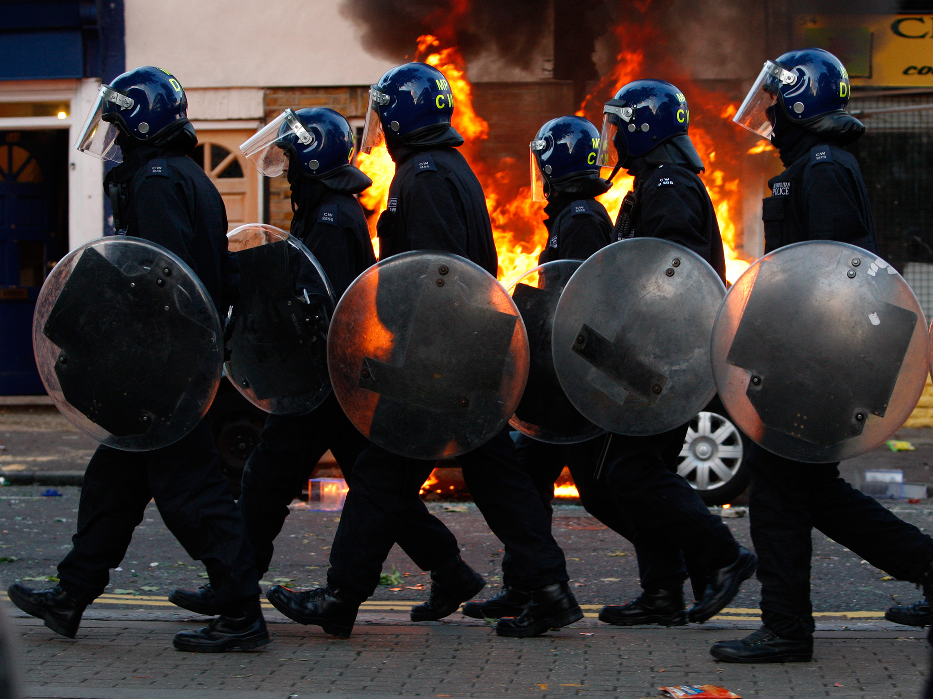
6. Section B: Police
Section B: Writing
You are advised to spend about 45 minutes on this section.
Write in full sentences.
You are reminded of the need to plan your answer.
You should leave enough time to check your work at the end.
Q5. Either: Write a description suggested by this picture:
Or: Write the opening of a crime or mystery story.
(24 marks for content and organisation
16 marks for technical accuracy)
[40 marks]
Plan:

Slide 32
Responses:
______________________________________________________________________________________________________________________________________________________________________________________________________________________________________________________________________________________________________________________________________________________________________________________________________________________________________________________________________________________________________________________________________________________________________________________________________________________________________________________________________________________________________________________________________________________________________________________________________________________________________________________________________________________________________________________________________________________________________________________________________________________________________________________________________________________________________________________________________________________________________________________________________________________________________________________________________________________________________________________________________________________________________________________________________________________________________________________________________________________________________________________________________________________________________________________________________________________________________________________________________________________________________________________________________________________________________________________________________________________________________________________________________________________________________________________________________________________________________________________________________________________________________________________________________________________________________________________________________________________________________________________________________________________________________________________________________________________________________________________________________________________________________________________________________________________________________________________________________________________________________________________________________________________________________________________________

Slide 33
________________________________________________________________________________________________________________________________________________________________________________________________________________________________________________________________________________________________________________________________________________________________________________________________________________________________________________________________________________________________________________________________________________________________________________________________________________________________________________________________________________________________________________________________________________________________________________________________________________________________________________________________________________________________________________________________________________________________________________________________________________________________________________________________________________________________________________________________________________________________________________________________________________________________________________________________________________________________________________________________________________________________________________________________________________________________________________________________________________________________________________________________________________________________________________________________________________________________________________________________________________________________________________________________________________________________________________________________________________________________________________________________________________________________________________________________________________________________________________________________________________________________________________________________________________________________________________________________________________________________________________________________________________________________________________________________________________________________________________________________________________________________________________________________________________________________________________________________________________________________________________________________________________________________________________________________________________________________________________________

Slide 34
________________________________________________________________________________________________________________________________________________________________________________________________________________________________________________________________________________________________________________________________________________________________________________________________________________________________________________________________________________________________________________________________________________________________________________________________________________________________________________________________________________________________________________________________________________________________________________________________________________________________________________________________________________________________________________________________________________________________________________________________________________________________________________________________________________________________________________________________________________________________________________________________________________________________________________________________________________________________________________________________________________________________________________________________________________________________________________________________________________________________________________________________________________________________________________________________________________________________________________________________________________________________________________________________________________________________________________________________________________________________________________________________________________________________________________________________________________________________________________________________________________________________________________________________________________________________________________________________________________________________________________________________________________________________________________________________________________________________________________________________________________________________________________________________________________________________________________________________________________________________________________________________________________________________________________________________________________________________________________________

Slide 35
7. Section A: Two Old Women
This extract is from the opening of a novel by Velma Wallis.
Two Old Women
In this particular band* were two old women cared for by The People* for many years. The older woman’s name was Ch’idzigyaak, for she reminded her parents of a chickadee bird when she was born. The other woman’s name was Sa’, meaning ”star,” because at the time of her birth her mother had been looking at the fall night sky, concentrating on the distant stars to take her mind away from the painful labour contractions.
The chief would instruct the younger men to set up shelters for these two old women each time the band arrived at a new campsite, and to provide them with wood and water. The younger women pulled the two elder women’s possessions from one camp to the next and, in turn, the old women tanned* animal skins for those who helped them. The arrangement worked well.
However, the two old women shared a character flaw unusual for people of those times. Constantly they complained of aches and pains, and they carried walking sticks to attest to their handicaps. Surprisingly, the others seemed not to mind, despite having been taught from the days of their childhood that weakness was not tolerated among the inhabitants of this harsh motherland. Yet, no one reprimanded the two women, and they continued to travel with the stronger ones – until one fateful day.
On that day, something more than the cold hung in the air as The People gathered around their few flickering fires and listened to the chief. He was a man who stood almost a head taller than the other men. From within the folds of his parka ruff he spoke about the cold, hard days they were to expect and of what each would have to contribute if they were to survive the winter.
Then, in a loud, clear voice he made a sudden announcement: ”The council and I have arrived at a decision.” The chief paused as if to find the strength to voice his next words. ”We are going to have to leave the old ones behind.”
His eyes quickly scanned the crowd for reactions. But the hunger and cold had taken their toll, and The People did not seem to be shocked. Many expected this to happen, and some thought it for the best. In those days, leaving the old behind in times of starvation was not an unknown act, although in this band it was happening for the first time. The starkness of the primitive land seemed to demand it, as the people, to survive, were forced to imitate some of the ways of the animals. Like the younger, more able wolves who shun the old leader of the pack, these people would leave the old behind so that they could move faster without the extra burden.
The older woman, Ch’idzigyaak, had a daughter and a grandson among the group. The chief looked into the crowd for them and saw that they, too, had shown no reaction. Greatly relieved that the unpleasant announcement had been made without incident, the chief instructed everyone to pack immediately. Meanwhile, this brave man who was their leader could not bring himself to look at the two old women, for he did not feel so strong now.
The chief understood why The People who cared for the old women did not raise objections. In these hard times, many of the men became frustrated and were angered easily, and one wrong thing said or done could cause an uproar and make matters worse. So it was that the weak and beaten members of the tribe kept what dismay they felt to themselves, for they knew that the cold could bring on a wave of panic followed by cruelty and brutality among people fighting for survival.
In the many years the women had been with the band, the chief had come to feel affection for them. Now, he wanted to be away as quickly as possible so that the two old women could not look at him and make him feel worse than he had ever felt in his life.
The two women sat old and small before the campfire with their chins held up proudly, disguising their shock. In their younger days they had seen very old people left behind, but they never expected such a fate.
*Glossary
band = a travelling Native American tribe
The People = fellow tribespeople
tanned = convert into leather

Slide 36
Section A: Reading
Answer all questions in this section.
You are advised to spend about 45 minutes on this section.
Q1. Read again the first part of the Source from lines 1 to 5.
List four things from this part of the text about Ch’idzigyaak and Sa’.
[4 marks]
1._____________________________________________________________________________________________________________________________________________
2._____________________________________________________________________________________________________________________________________________
3._____________________________________________________________________________________________________________________________________________
4._____________________________________________________________________________________________________________________________________________
Q2. Look in detail at this extract from lines 6 to 15 of the Source:
The chief would instruct the younger men to set up shelters for these two old women each time the band arrived at a new campsite, and to provide them with wood and water. The younger women pulled the two elder women’s possessions from one camp to the next and, in turn, the old women tanned* animal skins for those who helped them. The arrangement worked well.
However, the two old women shared a character flaw unusual for people of those times. Constantly they complained of aches and pains, and they carried walking sticks to attest to their handicaps. Surprisingly, the others seemed not to mind, despite having been taught from the days of their childhood that weakness was not tolerated among the inhabitants of this harsh motherland. Yet, no one reprimanded the two women, and they continued to travel with the stronger ones – until one fateful day.
How does the writer use language here to describe how the tribe look after the two old women?
You could include the writer’s choice of:
•words and phrases
•language features and techniques
•sentence forms
[8 marks]

Slide 37
Q3. You now need to think about the whole of the Source.
This extract comes from the opening chapter of the novel.
How has the writer structured the text to interest you as a reader?
You could write about:
•what the writer focuses your attention on at the beginning
•how and why the writer changes this focus as the Source develops
•any other structural features that interest you
[8 marks]
Q4. Focus this part of your answer on the second part of the Source from the line ‘Then, in a loud, clear voice he made a sudden announcement’, to the end.
A student, having read this section of the text, said: ‘This part of the story, where the chief announces that the old women are going to be left behind, shows he is a coward – I think he should have been brave enough to talk to the women directly and explain how badly he felt for them.’
To what extent do you agree?
In your response, you could:
•write about your own impressions of how the Chief announced the news
•evaluate how the writer conveys the Chief’s feelings and the tribe’s reaction to the news
•support your opinions with references to the text
[20 marks]

Slide 38
Responses:
______________________________________________________________________________________________________________________________________________________________________________________________________________________________________________________________________________________________________________________________________________________________________________________________________________________________________________________________________________________________________________________________________________________________________________________________________________________________________________________________________________________________________________________________________________________________________________________________________________________________________________________________________________________________________________________________________________________________________________________________________________________________________________________________________________________________________________________________________________________________________________________________________________________________________________________________________________________________________________________________________________________________________________________________________________________________________________________________________________________________________________________________________________________________________________________________________________________________________________________________________________________________________________________________________________________________________________________________________________________________________________________________________________________________________________________________________________________________________________________________________________________________________________________________________________________________________________________________________________________________________________________________________________________________________________________________________________________________________________________________________________________________________________________________________________________________________________________________________________________________________________________________________________________________________________________________

Slide 39
________________________________________________________________________________________________________________________________________________________________________________________________________________________________________________________________________________________________________________________________________________________________________________________________________________________________________________________________________________________________________________________________________________________________________________________________________________________________________________________________________________________________________________________________________________________________________________________________________________________________________________________________________________________________________________________________________________________________________________________________________________________________________________________________________________________________________________________________________________________________________________________________________________________________________________________________________________________________________________________________________________________________________________________________________________________________________________________________________________________________________________________________________________________________________________________________________________________________________________________________________________________________________________________________________________________________________________________________________________________________________________________________________________________________________________________________________________________________________________________________________________________________________________________________________________________________________________________________________________________________________________________________________________________________________________________________________________________________________________________________________________________________________________________________________________________________________________________________________________________________________________________________________________________________________________________________________________________________________________________

Slide 40
________________________________________________________________________________________________________________________________________________________________________________________________________________________________________________________________________________________________________________________________________________________________________________________________________________________________________________________________________________________________________________________________________________________________________________________________________________________________________________________________________________________________________________________________________________________________________________________________________________________________________________________________________________________________________________________________________________________________________________________________________________________________________________________________________________________________________________________________________________________________________________________________________________________________________________________________________________________________________________________________________________________________________________________________________________________________________________________________________________________________________________________________________________________________________________________________________________________________________________________________________________________________________________________________________________________________________________________________________________________________________________________________________________________________________________________________________________________________________________________________________________________________________________________________________________________________________________________________________________________________________________________________________________________________________________________________________________________________________________________________________________________________________________________________________________________________________________________________________________________________________________________________________________________________________________________________________________________________________________________

Slide 41
________________________________________________________________________________________________________________________________________________________________________________________________________________________________________________________________________________________________________________________________________________________________________________________________________________________________________________________________________________________________________________________________________________________________________________________________________________________________________________________________________________________________________________________________________________________________________________________________________________________________________________________________________________________________________________________________________________________________________________________________________________________________________________________________________________________________________________________________________________________________________________________________________________________________________________________________________________________________________________________________________________________________________________________________________________________________________________________________________________________________________________________________________________________________________________________________________________________________________________________________________________________________________________________________________________________________________________________________________________________________________________________________________________________________________________________________________________________________________________________________________________________________________________________________________________________________________________________________________________________________________________________________________________________________________________________________________________________________________________________________________________________________________________________________________________________________________________________________________________________________________________________________________________________________________________________________________________________________________________________

Slide 42
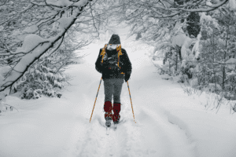
8. Section B: Journey
Section B: Writing
You are advised to spend about 45 minutes on this section.
Write in full sentences.
You are reminded of the need to plan your answer.
You should leave enough time to check your work at the end.
Q5. Either: Write a description suggested by this picture:
Or: Write the opening of a story about a person who gets abandoned.
(24 marks for content and organisation
16 marks for technical accuracy)
[40 marks]
Plan:

Slide 43
Responses:
______________________________________________________________________________________________________________________________________________________________________________________________________________________________________________________________________________________________________________________________________________________________________________________________________________________________________________________________________________________________________________________________________________________________________________________________________________________________________________________________________________________________________________________________________________________________________________________________________________________________________________________________________________________________________________________________________________________________________________________________________________________________________________________________________________________________________________________________________________________________________________________________________________________________________________________________________________________________________________________________________________________________________________________________________________________________________________________________________________________________________________________________________________________________________________________________________________________________________________________________________________________________________________________________________________________________________________________________________________________________________________________________________________________________________________________________________________________________________________________________________________________________________________________________________________________________________________________________________________________________________________________________________________________________________________________________________________________________________________________________________________________________________________________________________________________________________________________________________________________________________________________________________________________________________________________________

Slide 44
________________________________________________________________________________________________________________________________________________________________________________________________________________________________________________________________________________________________________________________________________________________________________________________________________________________________________________________________________________________________________________________________________________________________________________________________________________________________________________________________________________________________________________________________________________________________________________________________________________________________________________________________________________________________________________________________________________________________________________________________________________________________________________________________________________________________________________________________________________________________________________________________________________________________________________________________________________________________________________________________________________________________________________________________________________________________________________________________________________________________________________________________________________________________________________________________________________________________________________________________________________________________________________________________________________________________________________________________________________________________________________________________________________________________________________________________________________________________________________________________________________________________________________________________________________________________________________________________________________________________________________________________________________________________________________________________________________________________________________________________________________________________________________________________________________________________________________________________________________________________________________________________________________________________________________________________________________________________________________________

Slide 45
________________________________________________________________________________________________________________________________________________________________________________________________________________________________________________________________________________________________________________________________________________________________________________________________________________________________________________________________________________________________________________________________________________________________________________________________________________________________________________________________________________________________________________________________________________________________________________________________________________________________________________________________________________________________________________________________________________________________________________________________________________________________________________________________________________________________________________________________________________________________________________________________________________________________________________________________________________________________________________________________________________________________________________________________________________________________________________________________________________________________________________________________________________________________________________________________________________________________________________________________________________________________________________________________________________________________________________________________________________________________________________________________________________________________________________________________________________________________________________________________________________________________________________________________________________________________________________________________________________________________________________________________________________________________________________________________________________________________________________________________________________________________________________________________________________________________________________________________________________________________________________________________________________________________________________________________________________________________________________________

Slide 46
9. Section A: The Duchess and the Jeweller
This extract is from the opening of a novel by Virginia Woolf
The Duchess and the Jeweller
As usual, Oliver Bacon strode through the shop without speaking, though the four men, the two old men, Marshall and Spencer, and the two young men, Hammond and Wicks, stood straight and looked at him, envying him. It was only with one finger of the amber-coloured glove, waggling, that he acknowledged their presence. And he went in and shut the door of his private room behind him.
“So,” he half sighed, half snorted, “so——”
Then he touched a spring in the wall and slowly the panelling slid open, and behind it were the steel safes, five, no, six of them, all of burnished steel. He twisted a key; unlocked one; then another. Each was lined with a pad of deep crimson velvet; in each lay jewels—bracelets, necklaces, rings, tiaras, ducal coronets; loose stones in glass shells; rubies, emeralds, pearls, diamonds. All safe, shining, cool, yet burning, eternally, with their own compressed light.
“Tears!” said Oliver, looking at the pearls.
“Heart’s blood!” he said, looking at the rubies.
“Gunpowder!” he continued, rattling the diamonds so that they flashed and blazed.
“Gunpowder enough to blow Mayfair—sky high, high, high!” He threw his head back and made a sound like a horse neighing as he said it.
The telephone buzzed obsequiously in a low muted voice on his table. He shut the safe.
“In ten minutes,” he said. “Not before.” And he sat down at his desk and looked at the heads of the Roman emperors that were graved on his sleeve links. And again he dismantled himself and became once more the little boy playing marbles in the alley where they sell stolen dogs on Sunday. He became that wily astute little boy, with lips like wet cherries. He dabbled his fingers in ropes of tripe; he dipped them in pans of frying fish; he dodged in and out among the crowds. He was slim, lissome, with eyes like licked stones. And now—now—the hands of the clock ticked on, one two, three, four. . . . The Duchess of Lambourne waited his pleasure; the Duchess of Lambourne, daughter of a hundred Earls. She would wait for ten minutes on a chair at the counter. She would wait his pleasure. She would wait till he was ready to see her. He watched the clock in its shagreen case as the ten minutes passed. Then he heard soft slow footsteps approaching; a rustle in the corridor. The door opened. Mr. Hammond flattened himself against the wall.
“Her Grace!” he announced.
And he waited there, flattened against the wall.
And Oliver, rising, could hear the rustle of the dress of the Duchess as she came down the passage. Then she loomed up, filling the door, filling the room with the aroma, the prestige, the arrogance, the pomp, the pride of all the Dukes and Duchesses swollen in one wave. And as a wave breaks, she broke, as she sat down, spreading and splashing and falling over Oliver Bacon, the great jeweller, covering him with sparkling bright colours, green, rose, violet; and odours; and iridescences; and rays shooting from fingers, nodding from plumes, flashing from silk; for she was very large, very fat, tightly girt in pink taffeta, and past her prime. As a parasol with many flounces, as a peacock with many feathers, shuts its flounces, folds its feathers, so she subsided and shut herself as she sank down in the leather armchair.
“Good morning, Mr. Bacon,” said the Duchess. And she held out her hand which came through the slit of her white glove. And Oliver bent low as he shook it. And as their hands touched the link was forged between them once more. They were friends, yet enemies; he was master, she was mistress; each cheated the other, each needed the other, each feared the other, each felt this and knew this every time they touched hands thus in the little back room with the white light outside, and the tree with its six leaves, and the sound of the street in the distance and behind them the safes.

Slide 47
Section A: Reading
Answer all questions in this section.
You are advised to spend about 45 minutes on this section.
Q1. Read again the first part of the Source from lines 1 to 5.
List four things from this part of the text about Oliver Bacon.
[4 marks]
1._____________________________________________________________________________________________________________________________________________
2._____________________________________________________________________________________________________________________________________________
3._____________________________________________________________________________________________________________________________________________
4._____________________________________________________________________________________________________________________________________________
Q2. Look in detail at this extract from lines 7 to 15 of the Source:
Then he touched a spring in the wall and slowly the panelling slid open, and behind it were the steel safes, five, no, six of them, all of burnished steel. He twisted a key; unlocked one; then another. Each was lined with a pad of deep crimson velvet; in each lay jewels—bracelets, necklaces, rings, tiaras, ducal coronets; loose stones in glass shells; rubies, emeralds, pearls, diamonds. All safe, shining, cool, yet burning, eternally, with their own compressed light.
“Tears!” said Oliver, looking at the pearls.
“Heart’s blood!” he said, looking at the rubies.
“Gunpowder!” he continued, rattling the diamonds so that they flashed and blazed.
How does the writer use language here to convey Oliver Bacon’s views on jewels and the value of precious stones?
You could include the writer’s choice of:
•words and phrases
•language features and techniques
•sentence forms
[8 marks]

Slide 48
Q3. You now need to think about the whole of the Source.
This extract comes from the opening chapter of the novel.
How has the writer structured the text to interest you as a reader?
You could write about:
•what the writer focuses your attention on at the beginning
•how and why the writer changes this focus as the Source develops
•any other structural features that interest you
[8 marks]
Q4. Focus this part of your answer on the second part of the Source from the line ‘“Her Grace!” he announced’, to the end.
A student, having read this section of the text, said: ‘This part of the story, where Oliver Bacon greets the Duchess, shows that Oliver doesn’t like his wealthy customers. I think they’re as bad as each other.’
To what extent do you agree?
In your response, you could:
•write about your own impressions of the Duchess.
•evaluate how the writer conveys Bacon’s reactions to the Duchess
•support your opinions with references to the text
[20 marks]

Slide 49
Responses:
______________________________________________________________________________________________________________________________________________________________________________________________________________________________________________________________________________________________________________________________________________________________________________________________________________________________________________________________________________________________________________________________________________________________________________________________________________________________________________________________________________________________________________________________________________________________________________________________________________________________________________________________________________________________________________________________________________________________________________________________________________________________________________________________________________________________________________________________________________________________________________________________________________________________________________________________________________________________________________________________________________________________________________________________________________________________________________________________________________________________________________________________________________________________________________________________________________________________________________________________________________________________________________________________________________________________________________________________________________________________________________________________________________________________________________________________________________________________________________________________________________________________________________________________________________________________________________________________________________________________________________________________________________________________________________________________________________________________________________________________________________________________________________________________________________________________________________________________________________________________________________________________________________________________________________________________

Slide 50
________________________________________________________________________________________________________________________________________________________________________________________________________________________________________________________________________________________________________________________________________________________________________________________________________________________________________________________________________________________________________________________________________________________________________________________________________________________________________________________________________________________________________________________________________________________________________________________________________________________________________________________________________________________________________________________________________________________________________________________________________________________________________________________________________________________________________________________________________________________________________________________________________________________________________________________________________________________________________________________________________________________________________________________________________________________________________________________________________________________________________________________________________________________________________________________________________________________________________________________________________________________________________________________________________________________________________________________________________________________________________________________________________________________________________________________________________________________________________________________________________________________________________________________________________________________________________________________________________________________________________________________________________________________________________________________________________________________________________________________________________________________________________________________________________________________________________________________________________________________________________________________________________________________________________________________________________________________________________________________

Slide 51
________________________________________________________________________________________________________________________________________________________________________________________________________________________________________________________________________________________________________________________________________________________________________________________________________________________________________________________________________________________________________________________________________________________________________________________________________________________________________________________________________________________________________________________________________________________________________________________________________________________________________________________________________________________________________________________________________________________________________________________________________________________________________________________________________________________________________________________________________________________________________________________________________________________________________________________________________________________________________________________________________________________________________________________________________________________________________________________________________________________________________________________________________________________________________________________________________________________________________________________________________________________________________________________________________________________________________________________________________________________________________________________________________________________________________________________________________________________________________________________________________________________________________________________________________________________________________________________________________________________________________________________________________________________________________________________________________________________________________________________________________________________________________________________________________________________________________________________________________________________________________________________________________________________________________________________________________________________________________________________

Slide 52
________________________________________________________________________________________________________________________________________________________________________________________________________________________________________________________________________________________________________________________________________________________________________________________________________________________________________________________________________________________________________________________________________________________________________________________________________________________________________________________________________________________________________________________________________________________________________________________________________________________________________________________________________________________________________________________________________________________________________________________________________________________________________________________________________________________________________________________________________________________________________________________________________________________________________________________________________________________________________________________________________________________________________________________________________________________________________________________________________________________________________________________________________________________________________________________________________________________________________________________________________________________________________________________________________________________________________________________________________________________________________________________________________________________________________________________________________________________________________________________________________________________________________________________________________________________________________________________________________________________________________________________________________________________________________________________________________________________________________________________________________________________________________________________________________________________________________________________________________________________________________________________________________________________________________________________________________________________________________________________

Slide 53
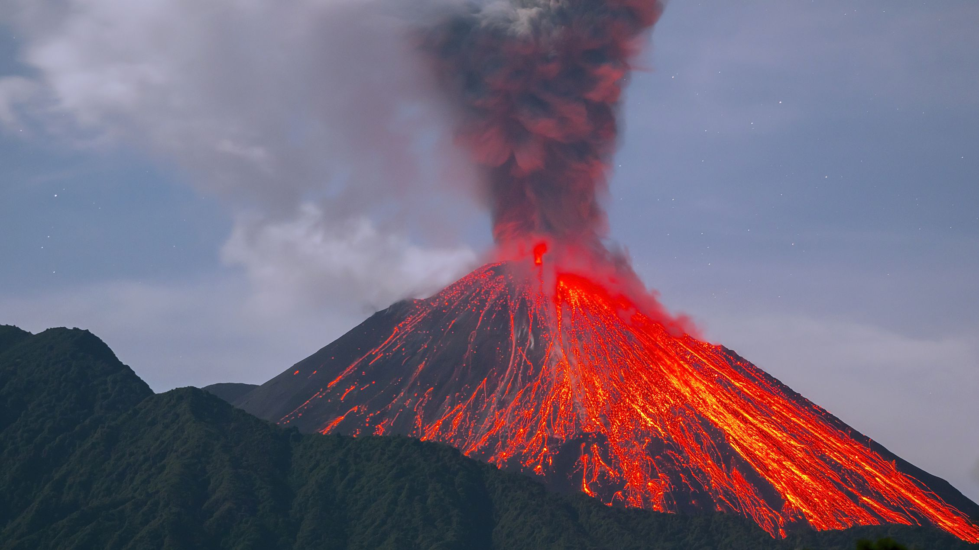
10. Section B: Natural Disaster
Section B: Writing
You are advised to spend about 45 minutes on this section.
Write in full sentences.
You are reminded of the need to plan your answer.
You should leave enough time to check your work at the end.
Q5. Either: Write a description suggested by this picture:
Or: Write the opening of a story about weather disaster.
(24 marks for content and organisation
16 marks for technical accuracy)
[40 marks]
Plan:

Slide 54
Responses:
______________________________________________________________________________________________________________________________________________________________________________________________________________________________________________________________________________________________________________________________________________________________________________________________________________________________________________________________________________________________________________________________________________________________________________________________________________________________________________________________________________________________________________________________________________________________________________________________________________________________________________________________________________________________________________________________________________________________________________________________________________________________________________________________________________________________________________________________________________________________________________________________________________________________________________________________________________________________________________________________________________________________________________________________________________________________________________________________________________________________________________________________________________________________________________________________________________________________________________________________________________________________________________________________________________________________________________________________________________________________________________________________________________________________________________________________________________________________________________________________________________________________________________________________________________________________________________________________________________________________________________________________________________________________________________________________________________________________________________________________________________________________________________________________________________________________________________________________________________________________________________________________________________________________________________________________

Slide 55
________________________________________________________________________________________________________________________________________________________________________________________________________________________________________________________________________________________________________________________________________________________________________________________________________________________________________________________________________________________________________________________________________________________________________________________________________________________________________________________________________________________________________________________________________________________________________________________________________________________________________________________________________________________________________________________________________________________________________________________________________________________________________________________________________________________________________________________________________________________________________________________________________________________________________________________________________________________________________________________________________________________________________________________________________________________________________________________________________________________________________________________________________________________________________________________________________________________________________________________________________________________________________________________________________________________________________________________________________________________________________________________________________________________________________________________________________________________________________________________________________________________________________________________________________________________________________________________________________________________________________________________________________________________________________________________________________________________________________________________________________________________________________________________________________________________________________________________________________________________________________________________________________________________________________________________________________________________________________________________

Slide 56
________________________________________________________________________________________________________________________________________________________________________________________________________________________________________________________________________________________________________________________________________________________________________________________________________________________________________________________________________________________________________________________________________________________________________________________________________________________________________________________________________________________________________________________________________________________________________________________________________________________________________________________________________________________________________________________________________________________________________________________________________________________________________________________________________________________________________________________________________________________________________________________________________________________________________________________________________________________________________________________________________________________________________________________________________________________________________________________________________________________________________________________________________________________________________________________________________________________________________________________________________________________________________________________________________________________________________________________________________________________________________________________________________________________________________________________________________________________________________________________________________________________________________________________________________________________________________________________________________________________________________________________________________________________________________________________________________________________________________________________________________________________________________________________________________________________________________________________________________________________________________________________________________________________________________________________________________________________________________________________

